Slide 1

Applied network science in cancer research
Borbála Kovács MD., PhD student
Supervisor: Prof. Peter Csermely

Slide 2
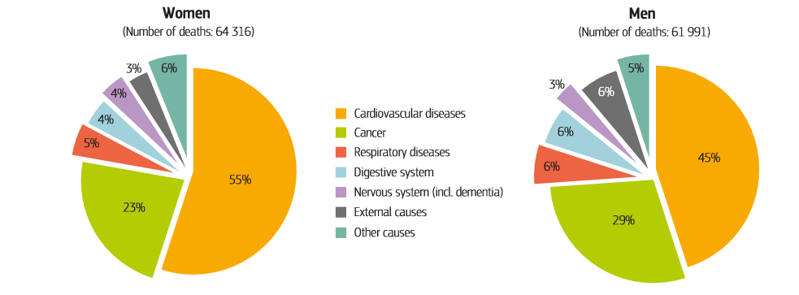
About cancer
„A term for diseases in which abnormal cells divide without control and can invade nearby tissues. Cancer cells can also spread to other parts of the body through the blood and lymph systems.”
Cancer therapeutics currently have the lowest clinical trial success rate of all major diseases. Partly as a result of the paucity of successful anti-cancer drugs, cancer will soon be the leading cause of mortality in developed countries.¹
¹Cagan, R., & Meyer, P. (2017). Rethinking cancer: current challenges and opportunities in cancer research. Disease models & mechanisms, 10(4), 349–352.

Slide 3
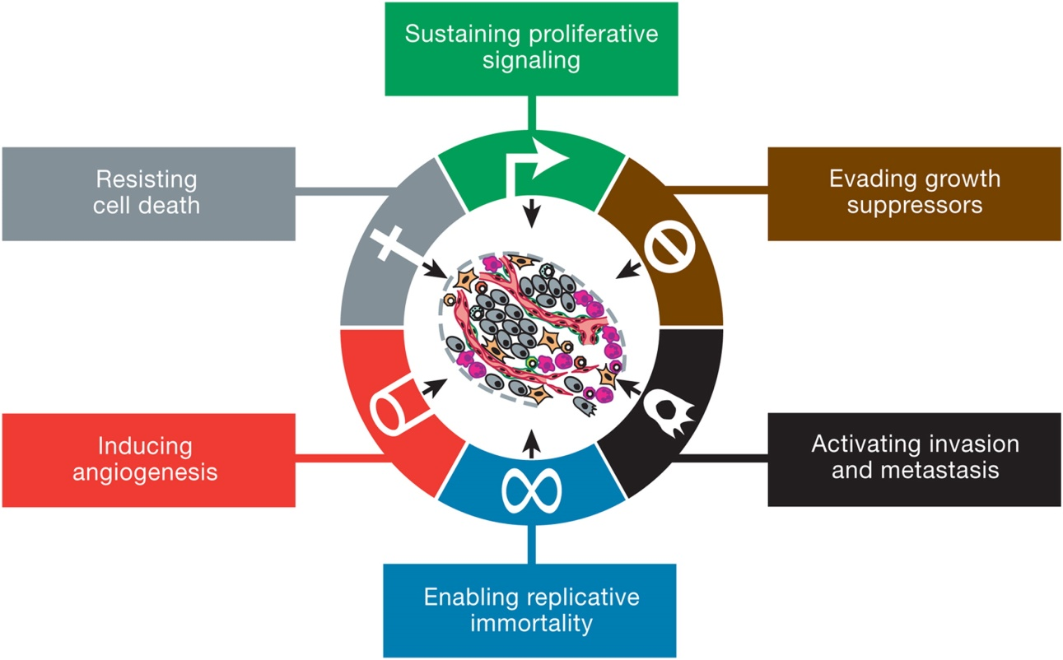
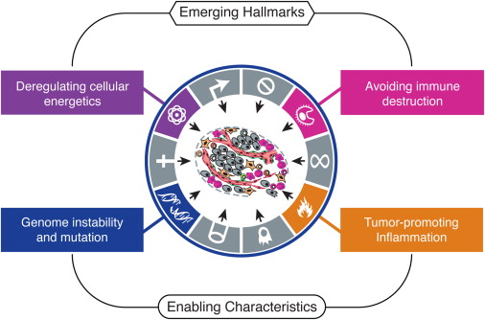
The hallmarks of cancer
Hanahan, D., & Weinberg, R. A. (2011). Hallmarks of cancer: the next generation. cell, 144(5), 646-674.
Notes:
Milyen eszközeink vannak a rákkutatásban

Slide 4
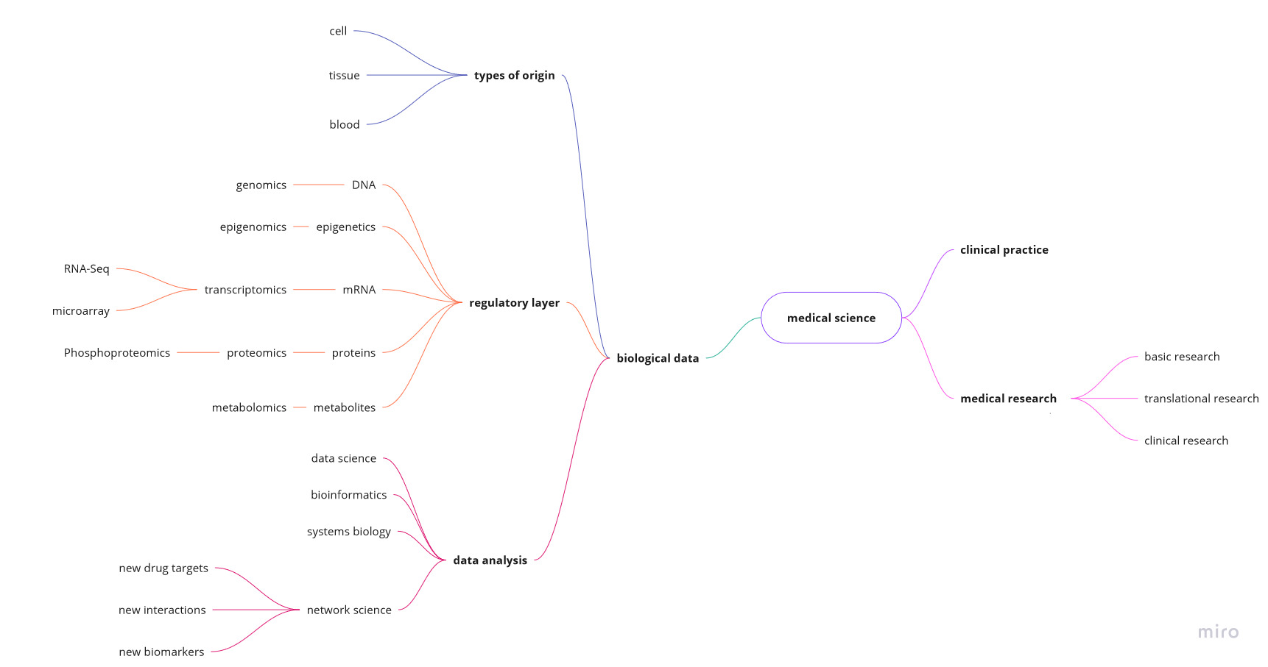
Medicine and networks – tools in cancer research
Notes:
Orvosi eszköztár elégtelen az adatelemzésben
rengeteg rákos adat
interdiszciplina
jó lenne belevilágítani egy sejtbe

Slide 5
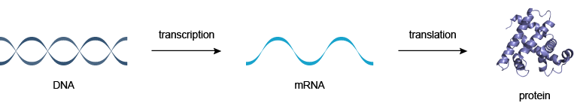
Biological data - layers
miRNAs
Genomics
Transcriptomics
Proteomics
Metabolomics
Notes:
Funkciója az adattípusnak
Fenotípus genotípus
Centrális dogma
miRNS-ek
Rákban mi romolhat el
Célszerű mindegyiket egyszerre elemezni

Slide 6
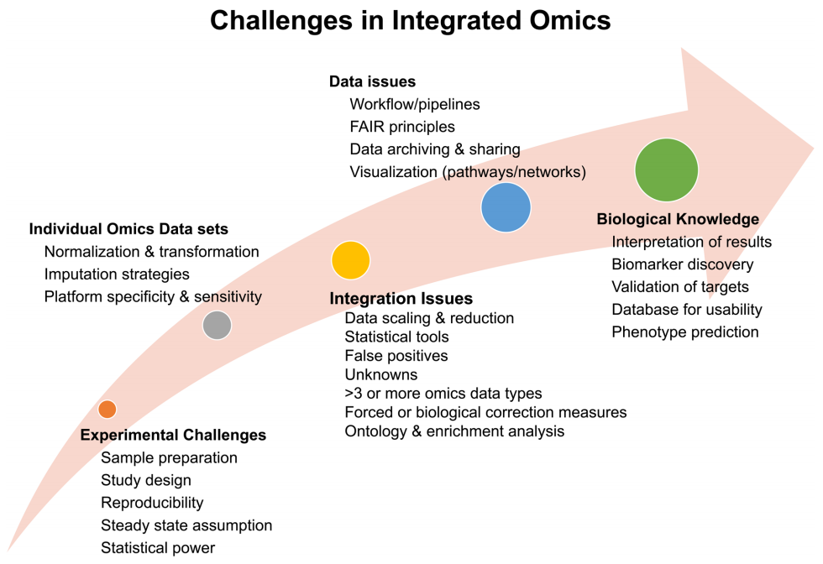
„Currently, there is no consensus for adopting a single workflow for data integration.”²
²Misra, B. B., Langefeld, C., Olivier, M., & Cox, L. A. (2018). Integrated omics: tools, advances and future approaches. Journal of Molecular Endocrinology, (2016), R21–R45.
Notes:
DE számos kihívás van benne
Kísérletes – minta előkészítés, reprodukálhatóság
Adatfeldolgozás, közös platform, integráció, skála, mértékegység
Nincsenek protokollok, általánosan elfogadott workflow-k
Minőségbizt.
Adatelemzés – módszerek
Biológiai interpretáció sem tiszta
De nagy potenciál van benne

Slide 7
Network science as a tool
„Big data”
1000 causes and 1000 effects – what is important?
Mathematics + visualisation
Modeling complex systems
Drug development
Notes:
Pont az ilyen adatokra jó a hálózat
Új összefüggéseket lelhetünk
Két agyfélteke egyszerre dolozik
Sejtek modellezésére, gysz fejlesztésre
Olcsó
Gyors

Slide 8
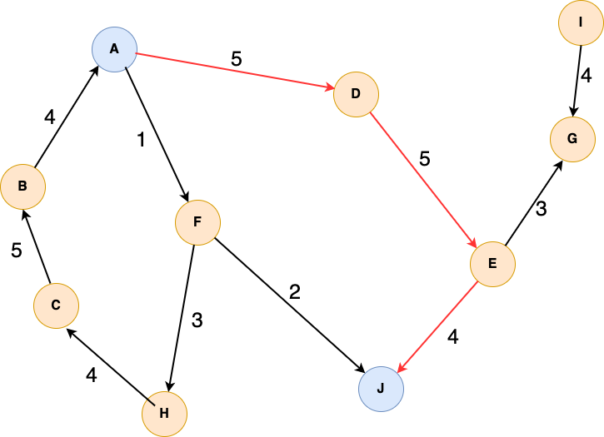
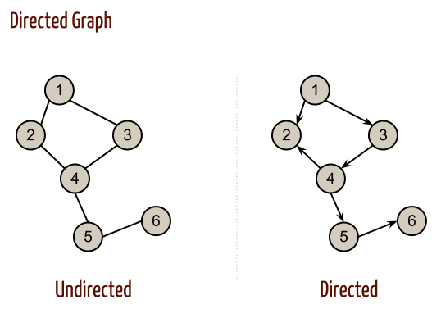
Graph theory basics – if a cancer cell was a network…
Node (source, sink) – [proteins]
Link/Edge (activation/inhibition/neutral) – [biological interaction]
Direction (information flow) – [eg. signaling]
Link weight/Edge weight (strength) – [probability of interaction]
Notes:
Ha egy rákos sejt hálózat lenne

Slide 9
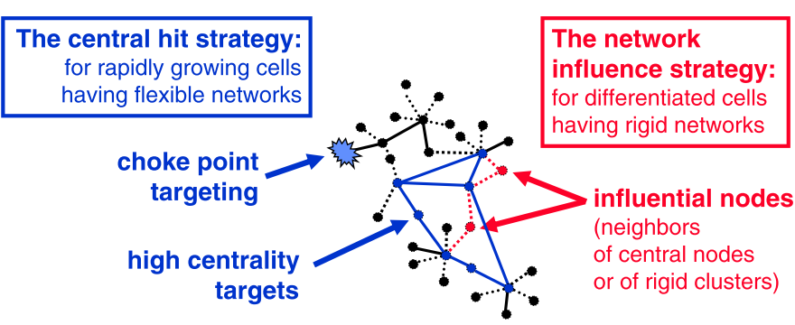
Network science and cancer therapy
cancer development
plasticity-rigidity
cycles
Most anti-cancer drugs
Good in early phase of cancer development
Precancerous states (adenomas)
Central targets may damage healthy cells too
Require a ‚well-defined’ attack
Indirect approach to avoid toxicity
Targeting the neighbours:
Allo-network drugs
Multiple ‚mild’ targets
Require an ‚under-defined’ attack
Csermely, Peter, et al. "Structure and dynamics of molecular networks: a novel paradigm of drug discovery: a comprehensive review." Pharmacology & therapeutics 138.3 (2013): 333-408.
Notes:
It is important to note that the central hit strategy is applied against
rapidly growing cells, such as those of infectious agents or cancer cells. Networks of these cells are in an ‘exploratory phase’, have larger entro- py (West et al., 2012), and are presumablymuchmore flexible, than the networks of differentiated cells. Efficient targeting of flexible systems having a high plasticity needs the targeting of their central nodes/ edges. This is the major mode through which the central hit strategy operates. In contrast, the network influence strategy is applied to differenti-
ated cells. Networks of these cells are in an ‘optimized phase’, where the optimum was re-set for a diseased cell to a different attractor of its state-space than that of healthy cells. Networks of differentiated cells are presumably much more rigid than the networks of rapidly growing, undifferentiated or dedifferentiated cells. This is true all the more, since diseases are typically recognized by their late- appearing manifestations (Loscalzo and Barabasi, 2011), where the corresponding network already reached the disease-specific, rigid state. Targeting the central nodes/edges of systems having a low plas- ticity may easily ‘over-saturate’ the system leading to a change, which becomes too large to be selective, and causes side-effects and toxicity. Therefore, the network influence strategy often needs an indirect ap- proach, where e.g. neighbors of the real target are targeted (allo- network drugs), or multiple targets are targeted ‘mildly’ (multi-target drugs), and their indirect and/or superposing effects lead to the reconfiguration of diseased network state back to normal.
Hogyan találjuk meg ezeket a targeteket?

Slide 10




Network topology I.
Small worldness and scale freeness
star network
scale-free
network
random
graph
subgraphs
complexity
stress
resources
Derényi et al (2003) Phys. A 334:583
Notes:
Skálafüggetlenek fokszám, de elméleti szinten a hálózatok h reagálnak stresszre… egyes részei a rákos hálónak megváltozhatnak

Slide 11
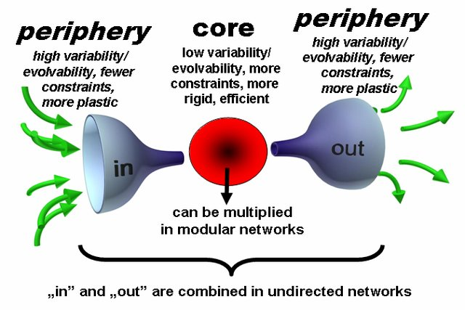
Network topology II. – core-periphery
Core-periphery structure – adaptation, learning – [carcinogenesis, drug resistance]
Csermely, P., London, A., Wu, L. Y., & Uzzi, B. (2013). Structure and dynamics of core/periphery networks. Journal of Complex Networks, 1(2)
Notes:
Érdemes lehet megvizsgálni a mag-repif. Szerkezetet, ugyanis ahogy azt Csermely prof.tól hallhatták már… dinamikusan változik a mérete a magnak
Perif. Szerepe a tanulás, plasztikusság, mag meg rigidebb. Ez fontos lehet ha a rák kialakulásában ill gysz rezisztenciában szerepet játszó tényezőket szeretnénk hálózatosan kideríteni.

Slide 12
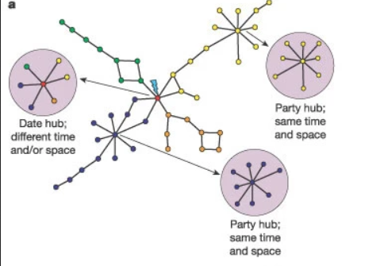
Network topology III. - hubs
Hubs (top 1% degree nodes):
Party hubs
  Mainly module cores
  Local organizers
  Binding their partners simultaneously
  Cancer drug targets
Date hubs
  Inter-modular position
  Frequently changing their protein partners
  Binding their partners sequentially
  Often mutated in cancer
Han, J. D. J., Bertin, N., Hao, T., Goldberg, D. S., Berriz, G. F., Zhang, L. V., ... & Vidal, M. (2004). Evidence for dynamically organized modularity in the yeast protein–protein interaction network. Nature, 430(6995), 88-93.
Notes:
Csomópontok keresése

Slide 13
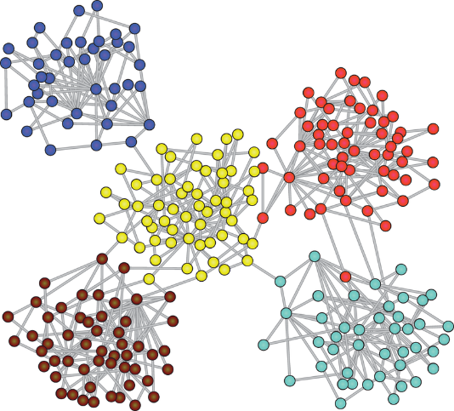
Network topology IV. - modules
Functional units [protein complexes]
Noise reduction
Division of labour
Relative independency and development
Hierarchy (module core)
Overlap – stress response
Inter-modular bridges
Bottlenecks
Notes:
A hlózattop. Nagyon fontos része a modulszerkezet vizsgálata. Különösen biológiai rendszerekben. A modulok funkc egységek, amik egy feladatra specializált csoportok. Nagy élsűrűség. Zajszűrő funkció is van. Elszigeteltség – jó és rossz is. Hierarchikusak – van közepe

Slide 14
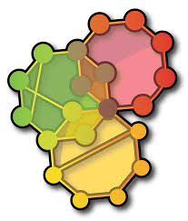
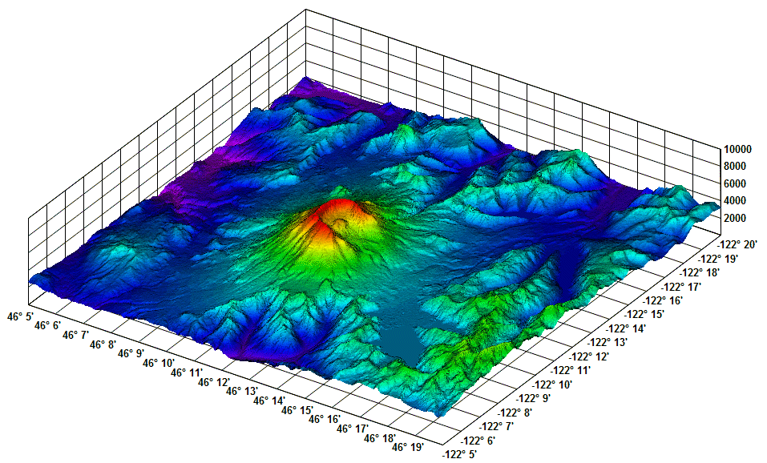
The ModuLand method - „Community landscapes”
Kovács, I. A., Palotai, R., Szalay, M. S., & Csermely, P. (2010). Community landscapes: an integrative approach to determine overlapping network module hierarchy, identify key nodes and predict network dynamics. PloS one, 5(9), e12528.
Notes:
Szemléltetésül egy példa

Slide 15
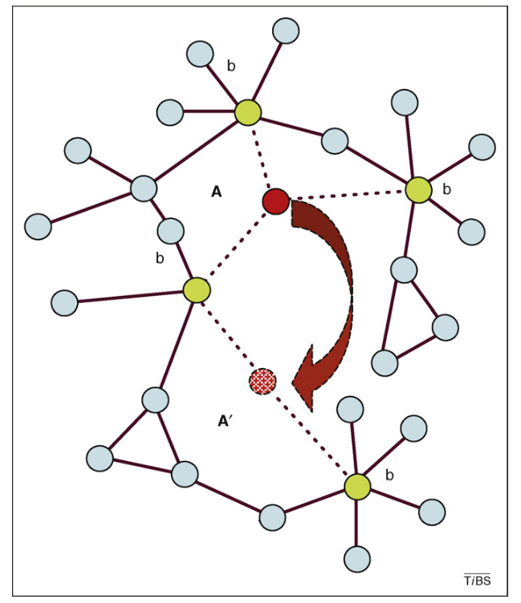
Network topology V. – creative nodes
Creative nodes – [intrinsicly disordered proteins?]
Connect elements that are not directly connected to each other
Connect to hubs
Intra-modular nodes
Provide short cuts
Low occurence – increases when fluctuating environment
„life insurance”
Csermely, P. (2008). Creative elements: network-based predictions of active centres in proteins and cellular and social networks. Trends in Biochemical Sciences, 33(12), 569–576
Notes:
Vannak a hálózatban ún. kreatív nódusok, akik az életbiztosítást jelentik. Speciális, különleges tulajdonságaik vannak, könnyen tudják megváltoztatni a pozíciójukat. Kiváltságos helyzet. Nézzük sorjában hogy mik ezek az ismérvek. Egyébként távol levő elemeket kötnek össze, csomópontokhoz közel vannak (info eljut), modulok közt vannak, rövidre zárhatnak utakat. Kevés van belőlük mert költségesek, de stressznél jól jön.

Slide 16
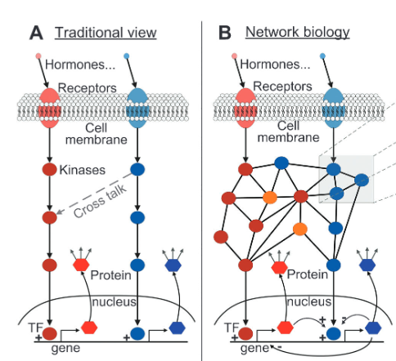
Signaling networks and cancer
Upstream: signaling pathways
Downstream: regulatory part (TFs, microRNAs)
Positive signaling regulatory network motifs: cancer driving mutating oncogenes
  Gain of function mutations
  Ras
Negative signaling regulatory network motifs: methylated genes and tumor suppressors
  Loss of function mutations
  p53
Triggering downstream cellular signals in cancer cells
  -> proliferation
Cancer network motifs: hotspots in signaling networks
Drug resistance and cross-talks
Cloutier, M., & Wang, E. (2011). Dynamic modeling and analysis of cancer cellular network motifs. Integrative Biology, 3(7), 724-732.
Notes:
Milyen hálózatokkal írhatjuk le a rákos sejteket?
Eleknek van iranya, precízen felepitett, sok hattertudas. Kisebb meret.
Jelátviteli pl. A hagyományos szemlélet egy utat vizsgál, de tudjuk, hogy ezek cross talkolnak, és biz. Esetben célszerűbb hálózatként tekinteni őket, nem lineáris útként a sejtmagba. Két részre oszthatjuk, upstream downstream. Hálózatos szempontból nézve a rákos mutációk úgy szólnak bele hogy… a poz/neg regulálóköröket zavarják meg. A rákban érintett hálózatos motívumok gyakran hotspotok a jelátviteli hálókban. A gyszrezz. Gyakran crosstalkokon keresztül megy, jobban átláthatjuk a képet ahálózatokkal.

Slide 17
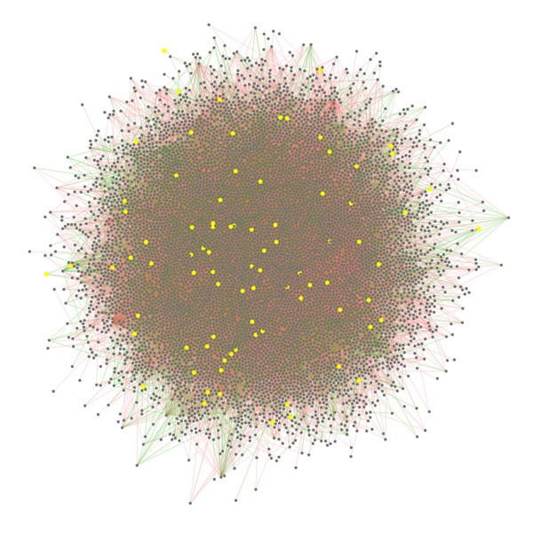
Protein-protein interaction networks and cancer
Interactome topology - drug target prediction
  Targeting only the interaction
Proteins with cancer specific mutations are:
  Hubs
  Rich-clubs
  Bottlenecks
Liu, H., Su, J., Li, J., Liu, H., Lv, J., Li, B., ... & Zhang, Y. (2011). Prioritizing cancer-related genes with aberrant methylation based on a weighted protein-protein interaction network. BMC systems biology, 5(1), 1-15.
Notes:
A feh-feh interakcios halozatok masik remek pelda a rakos sejtek modellezesere.
Sokszor csak az interakciot tudjuk, sokszor nem nagy biztonsaggal. Itt inkabb az a lenyeg hogy a fp osszefuggeseket meglassuk, nem a pontossag. Nagy meretu halozatok, reszletgazdag. Topologiai elemzeshez nagyon jok. A mutalt feherjek jellemzoen halozatosan hubok… stb. Lehet talalni nem csak nodusokat mint targeteket, hanem interakciokat is, amiket specifikusan lehet gatolni – kisebb mellekhatas varhato.

Slide 18
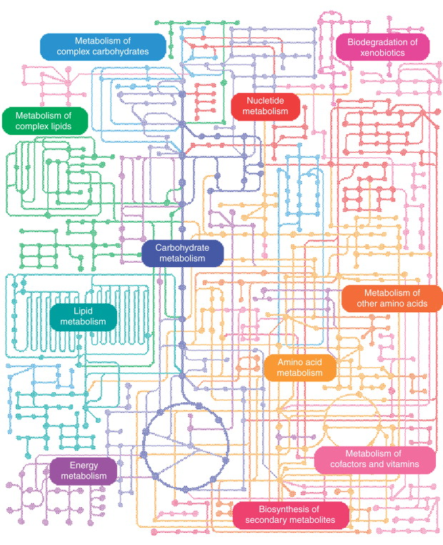
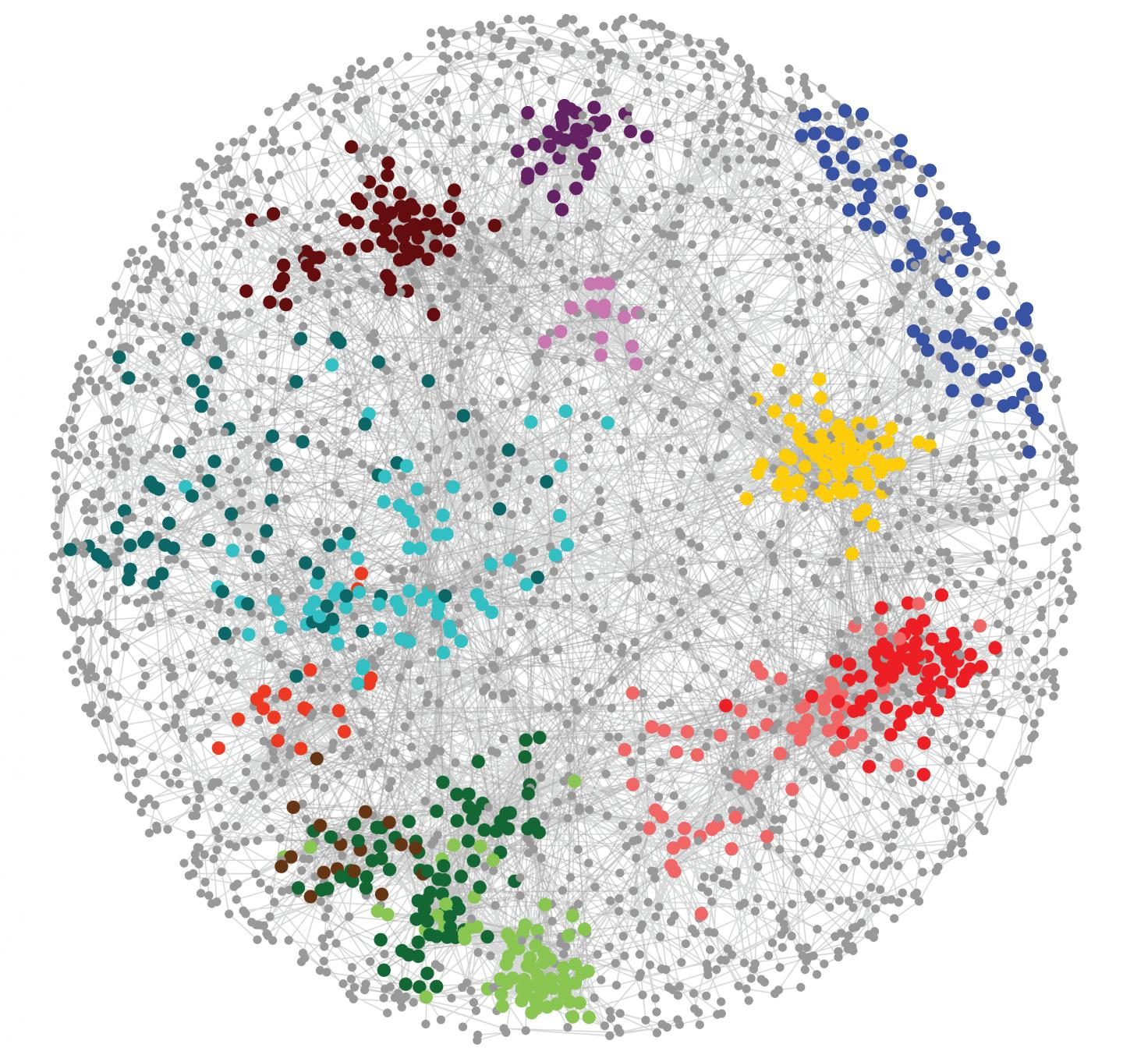
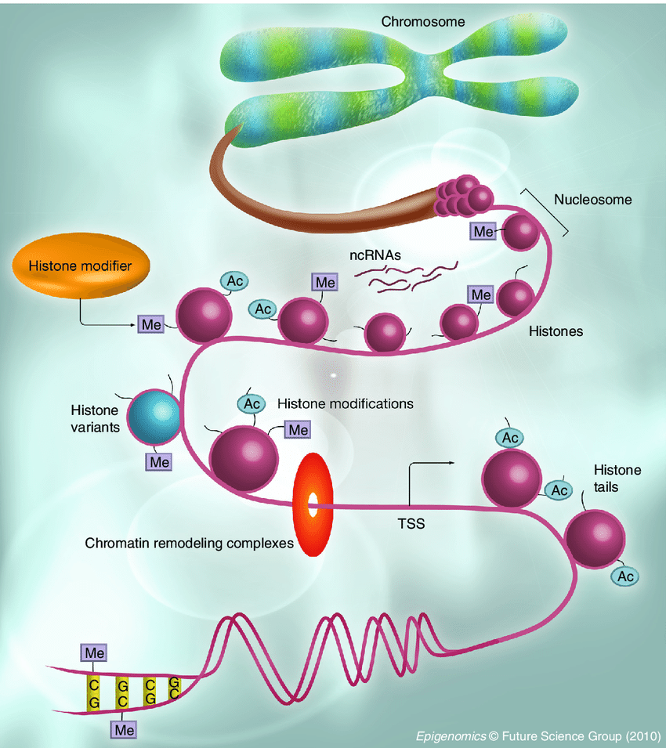
Other networks and cancer
Gene interaction networks
Chromatin and epigenetic netoworks
Metabolic networks
Notes:
Egyeb halozatok, pl, gen interakcios, kromatin es epigen., metabolikus….
The chromatin network determines cancer-associated chromosomal alterations

Slide 19
The next slides are examples of freely available networks, databases and other resources for cancer network research
Notes:
Szeretnek bemutatni peldakent par hasznos adatbazist es halozatot amelyek ingyenesen elerhetoek es hasznalhatoak.

Slide 20

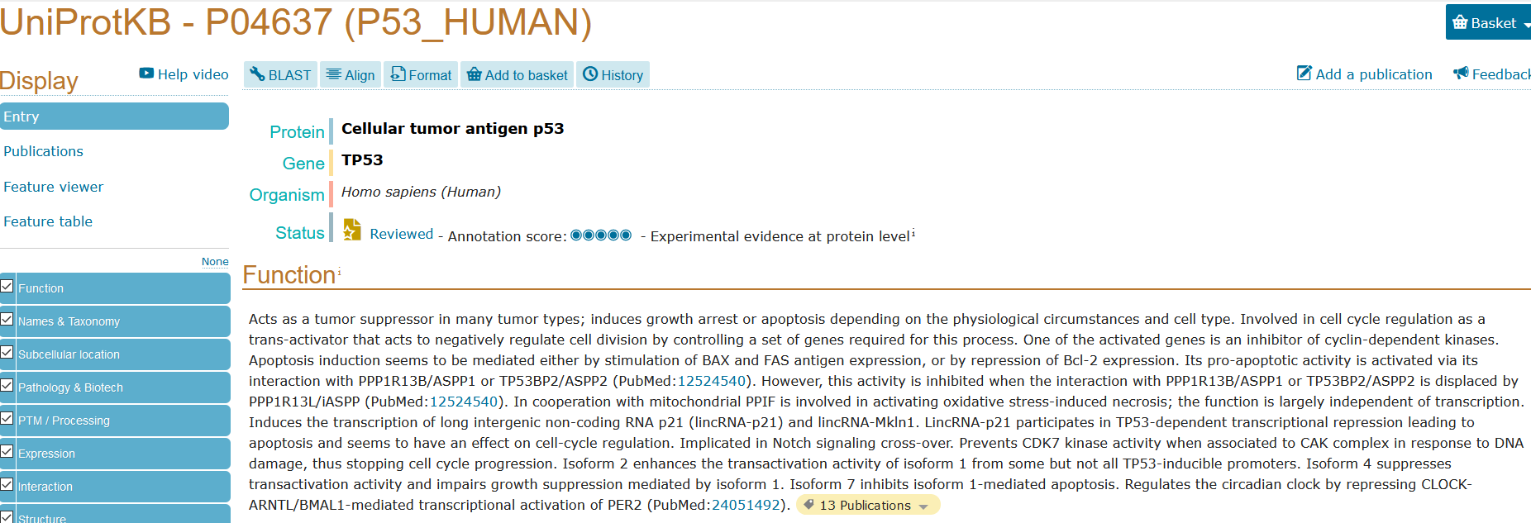

UniProt database
Notes:
A Uniprot adatbazis. Feherjeket gyujt ossze, es roluk minden letezo informaciot. Pl. p53rol rovid leiras, lokalizacio, interakciok, stb. Erdemes megnezni. Ami fontos az a unprot azonosito. Barm bioinfo munkat csinaltok ezzel talalkozni fogtok.

Slide 21
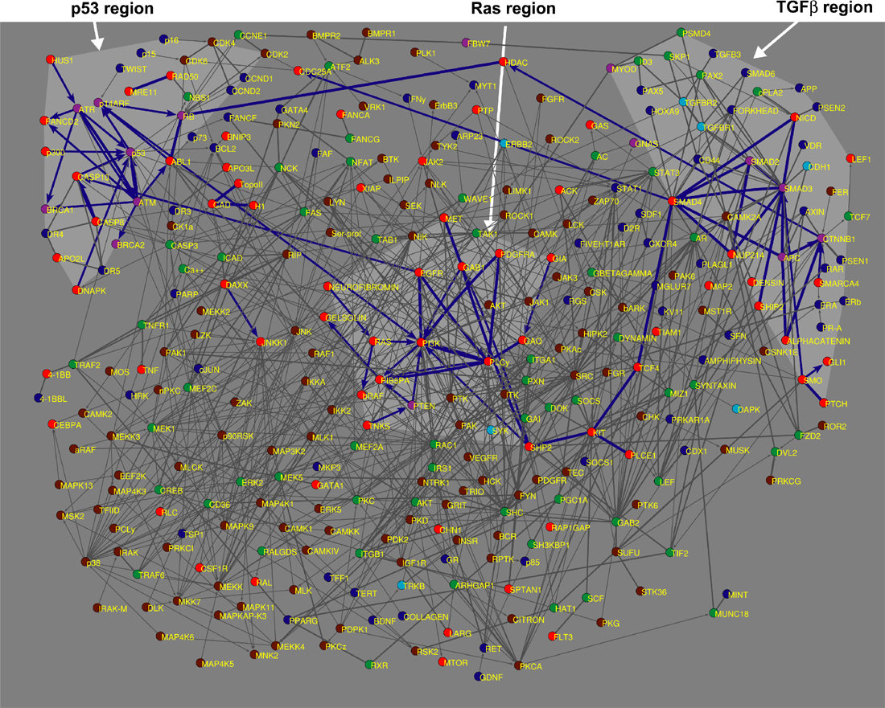
Human Cancer Signaling Network
Cui, Q., Ma, Y., Jaramillo, M., Bari, H., Awan, A., Yang, S., ... & Wang, E. (2007). A map of human cancer signaling. Molecular systems biology, 3(1), 152.
Notes:
2007-ben épült azzal a céllal h a rákban leggyakrabban érintett jelátv utakat tartalmazza es tanulmanyozhatoak legyenek. Iranyitott elek, megbizhato halo. Kozepes meret.

Slide 22
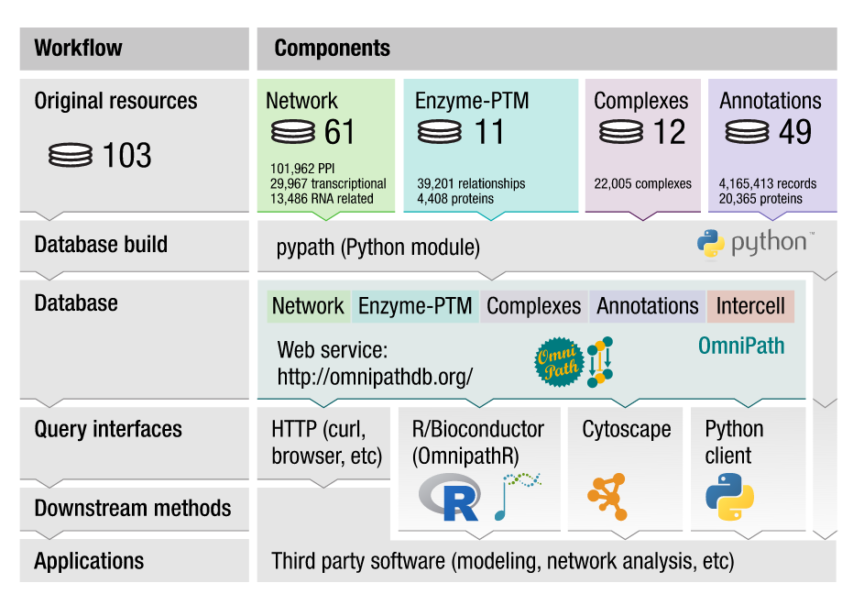
OmniPath (signaling network)
Türei, D., Korcsmáros, T., & Saez-Rodriguez, J. (2016). OmniPath: guidelines and gateway for literature-curated signaling pathway resources. Nature methods, 13(12), 966-967.
Notes:
OmniPath egy modern jelatv halozat, sokkal nagyobb. Sok forrast tartalmaz, szemelyre szabhato, reszletgazdag. Iranyitott elek, felhasznalobarat. Folyamatos update.

Slide 23

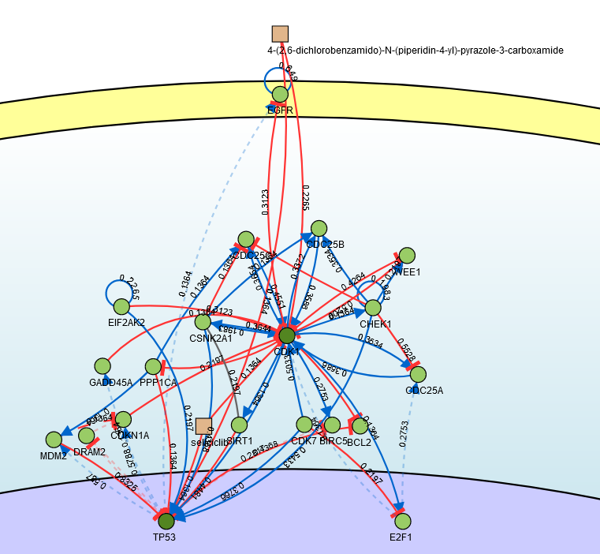
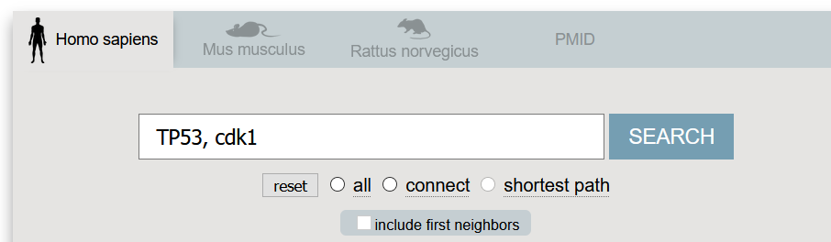
Notes:
Signor – shortest path-t is tud. Ket vagy tobb tetszoleges feherjet osszekotve csinal halozatot

Slide 24

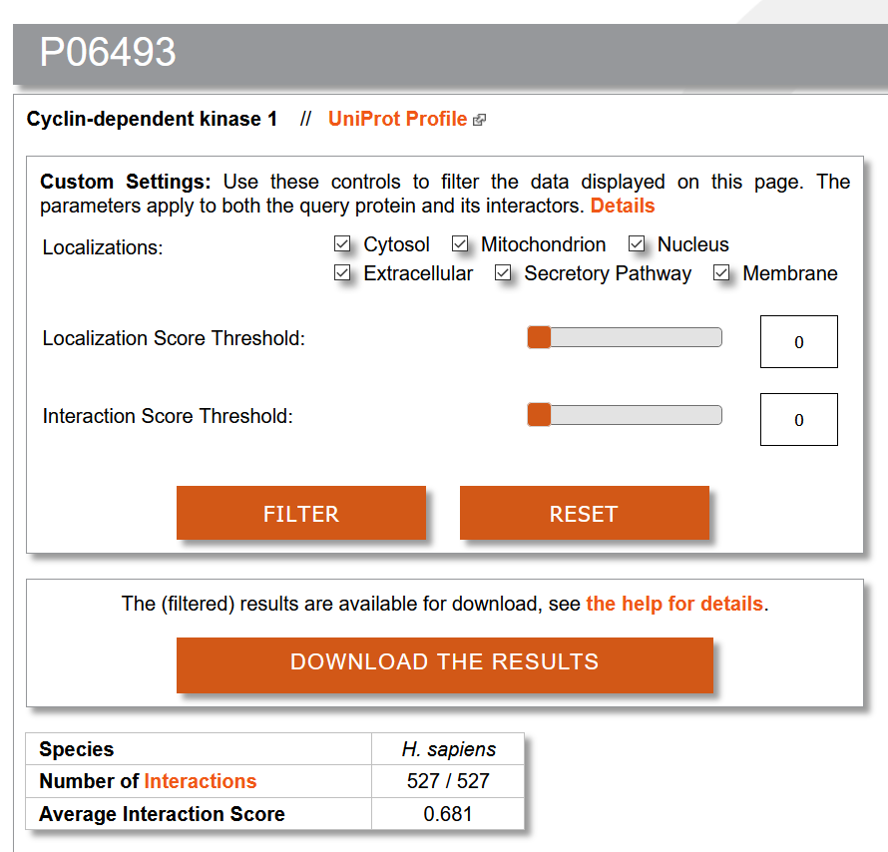
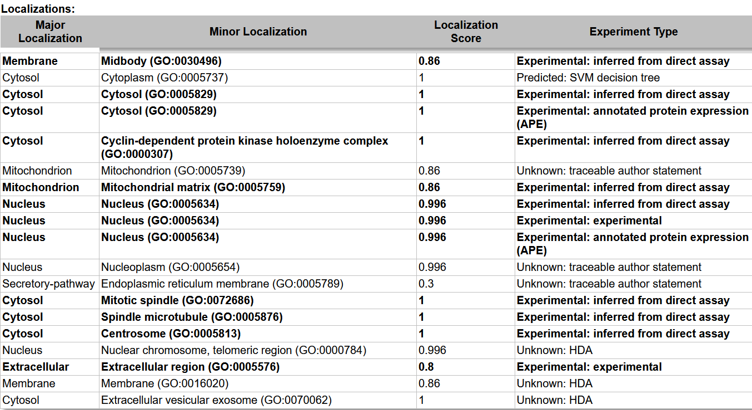
ComPPI – PPI networks + localization
Notes:
Feh-feh interakc halozatra remek pelda a comppi, amit a mi kutatocsoportunkban fejlesztettek. Lokalizacio info, halozatot csinal.

Slide 25
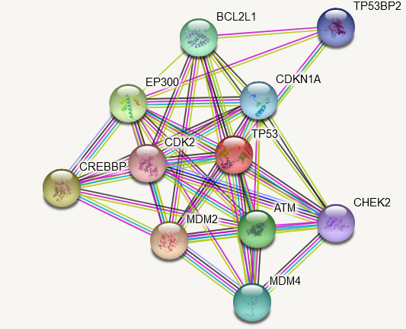
String – PPI interaction networks
STRING is a database of known and predicted protein-protein interactions. The interactions include direct (physical) and indirect (functional) associations; they stem from computational prediction, from knowledge transfer between organisms, and from interactions aggregated from other (primary) databases.
Notes:
Direkt, es indirekt interakciok, prediktaltak is vannak benne. Tagabb ertelmezes, laza.

Slide 26
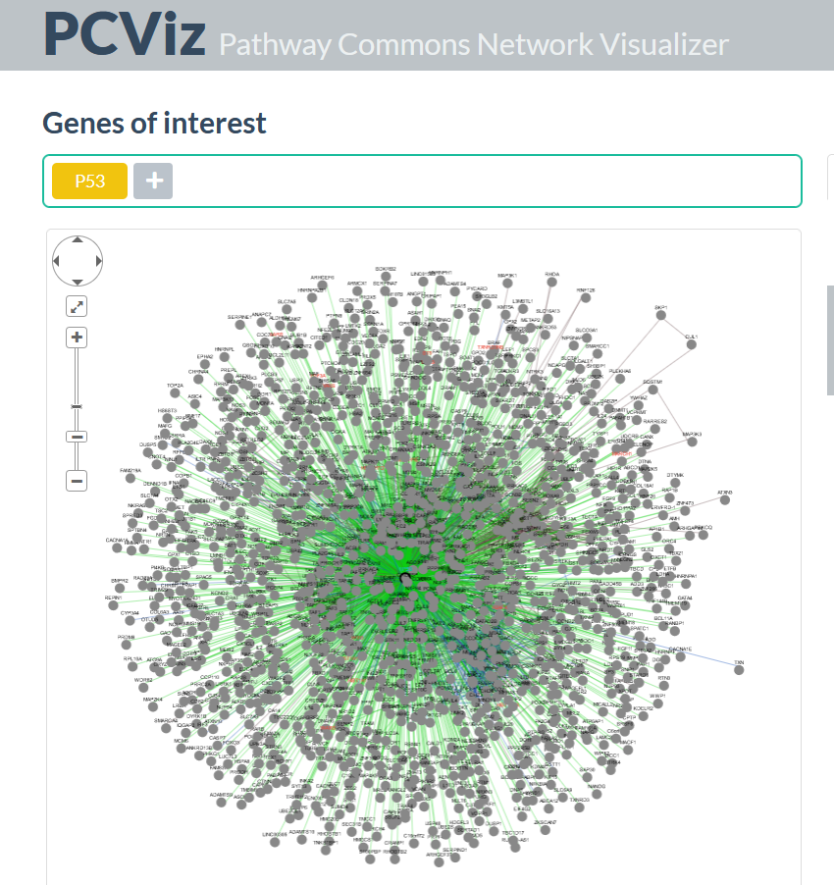
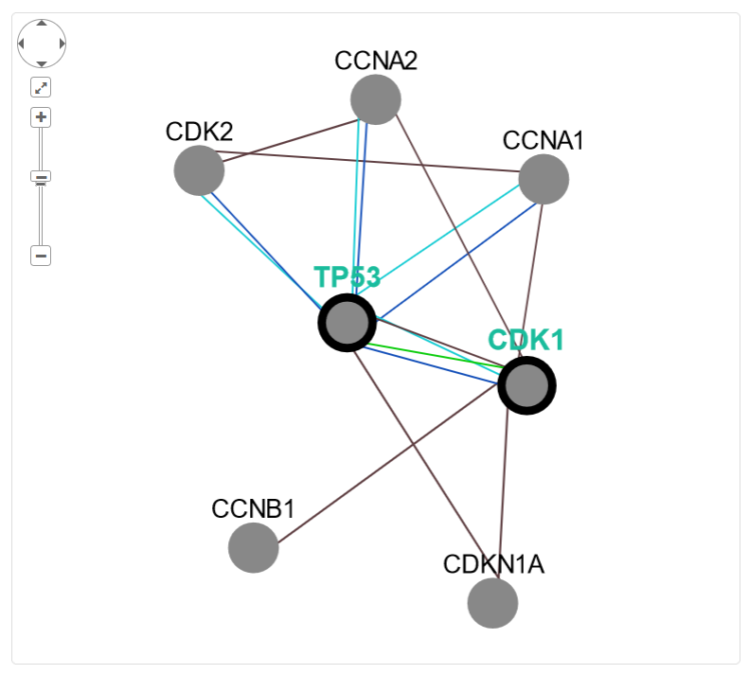
Pathway Commons – pathway and interaction database
Notes:
Tetszoleges genek kozott megkeresi a kozos eleket

Slide 27
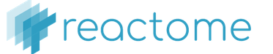

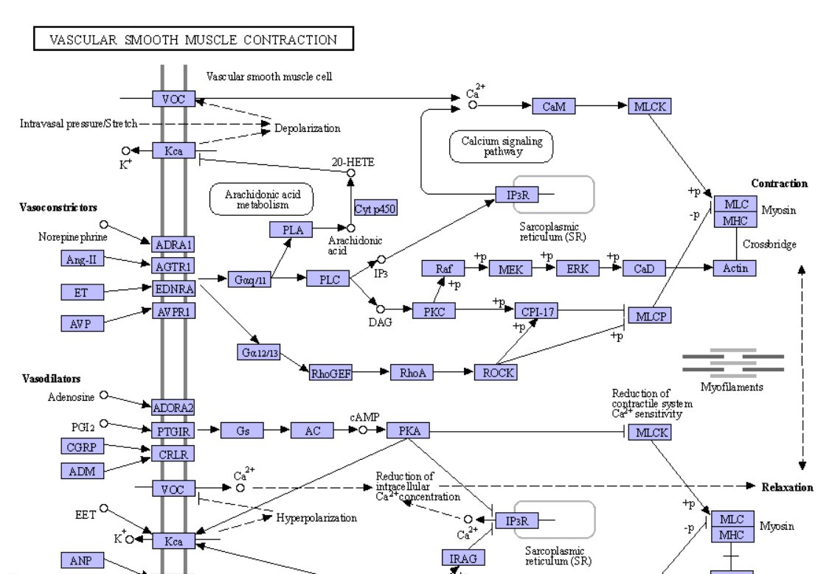
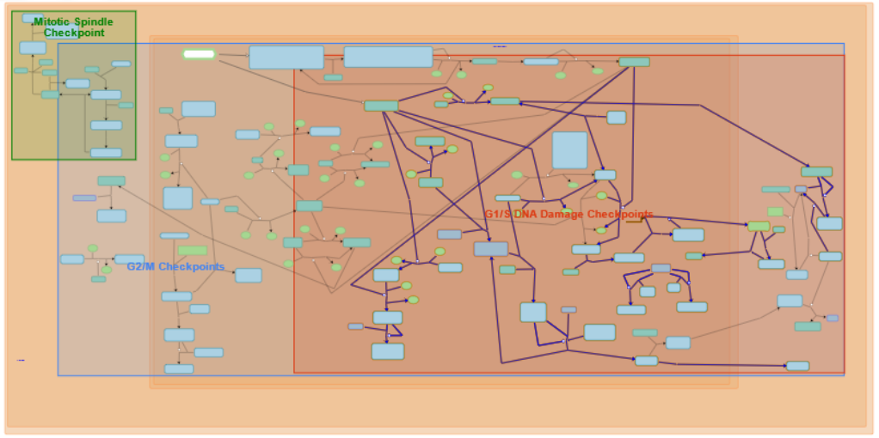
Pathway databases – Reactome, KEGG
Notes:
Reactome
KEGG
Útvonalakat gyűjtenek össze, mi mit aktival, folyamatabrak

Slide 28
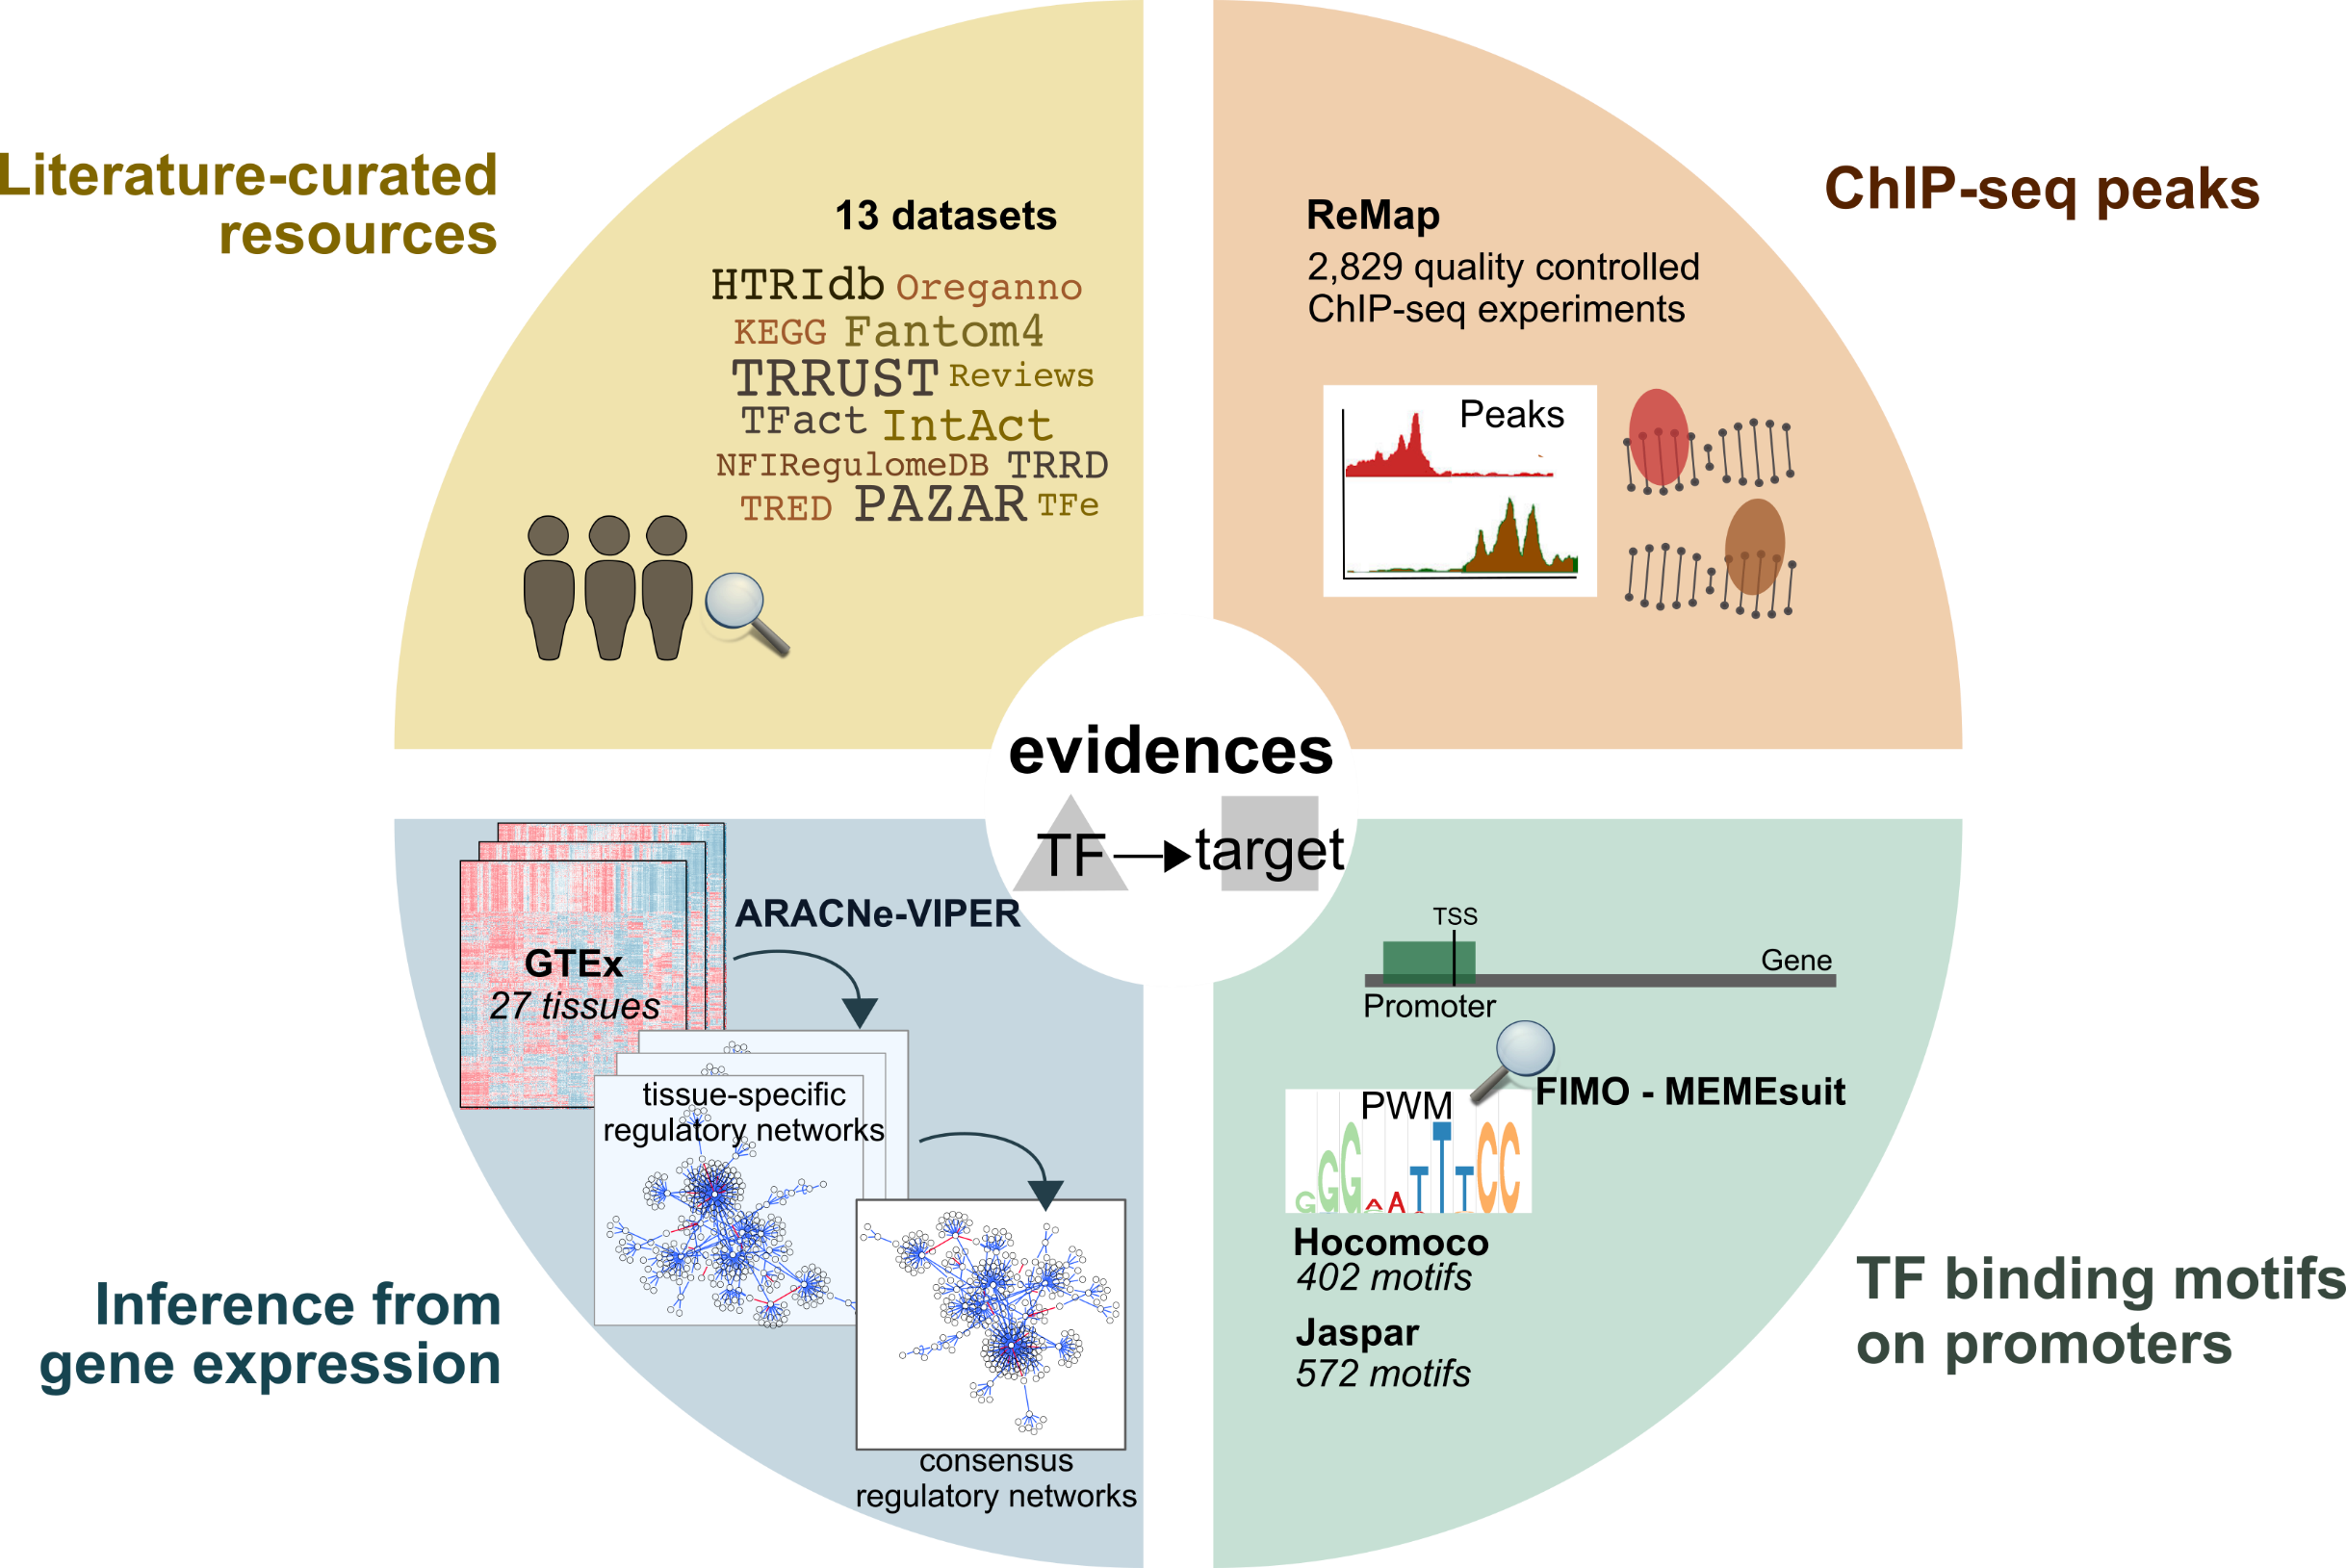

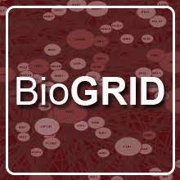
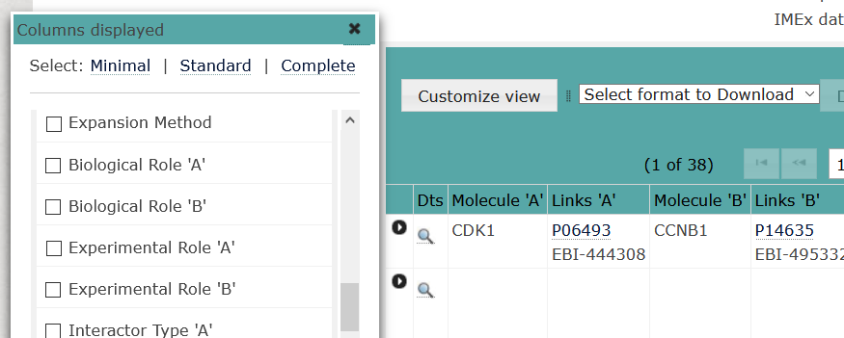
BioGRID DoRothEA IntAct
Notes:
BioGRID: interaction database
DoRothEA is a gene set resource containing signed transcription factor (TF) - target interactions first described in Garcia-Alonso et al., 2019. The collection of a TF and its transcriptional targets is defined as regulon. DoRothEA regulons were curated and collected from different types of evidence such as literature curated resources, ChIP-seq peaks, TF binding site motifs and interactions inferred directly from gene expression.
IntAct provides a freely available, open source database system and analysis tools for molecular interaction data. All interactions are derived from literature curation or direct user submissions and are freely available.

Slide 29




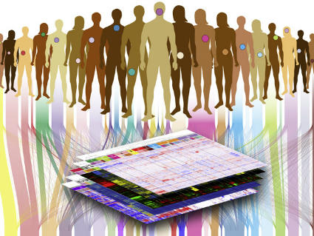

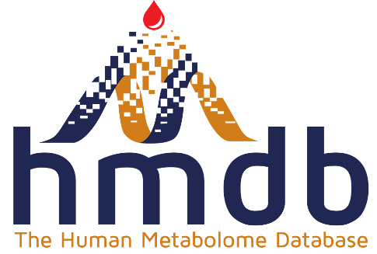
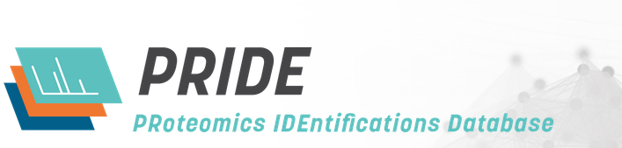


Cancer OMICS databases
20,000 primary cancer + normal samples
33 cancer types
Notes:
TCGA generated over 2.5 petabytes of genomic, epigenomic, transcriptomic, and proteomic data.

Slide 30
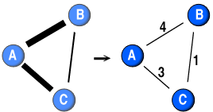
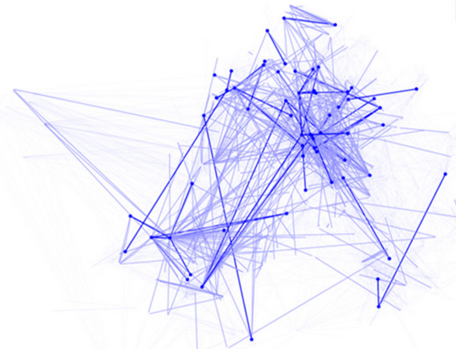
An example of transforming data to link weights
Abundances ~ concentrations
Link weight = product of abundances:
  Highlights upregulated genes
  Probability of the interaction
Schulc, K., Nagy, Z. T., Kamp, S., Molnár, J., Veres, D. V., Csermely, P., & Kovács, B. M. (2021). Modular Reorganization of Signaling Networks during the Development of Colon Adenoma and Carcinoma. The Journal of Physical Chemistry B, 125(7), 1716-1726.

Slide 31




Example: modeling the development of cancer
Healthy state
Benign tumor
Malign tumor
Normal colon
Colon adenoma
Colon adenocarcinoma
Normal esophagus
Barrett esophagus
Esophagus adenocarcinoma
Normal pancreas
PanIN
Pancreas adenocarcinoma
Normal gaster
Intestinal metaplasia
Intestinal gastric cancer

Slide 32

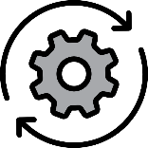
Example: modeling the development of cancer
workflow
Data collection and preparation:
Healthy state
Benign tumor
Malign tumor
+
Standard cancer signaling network
Calculating link weights
Normal network
Adenoma network
Carcinoma network
Network analysis

Slide 33
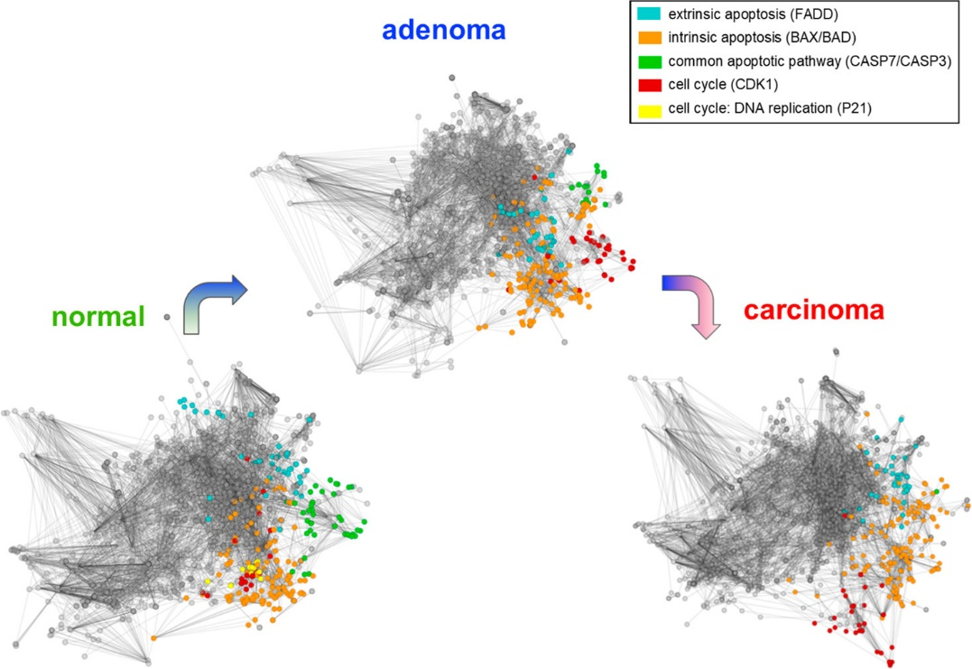
Modular reorganization of the Human Cancer Signaling Network in colon cancer
Schulc, K., Nagy, Z. T., Kamp, S., Molnár, J., Veres, D. V., Csermely, P., & Kovács, B. M. (2021). Modular Reorganization of Signaling Networks during the Development of Colon Adenoma and Carcinoma. The Journal of Physical Chemistry B, 125(7), 1716-1726.

Slide 34
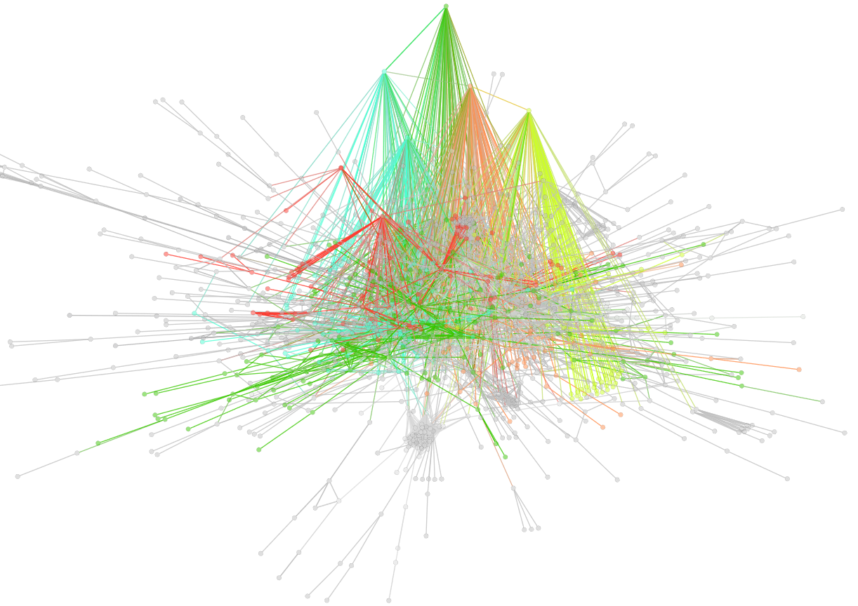
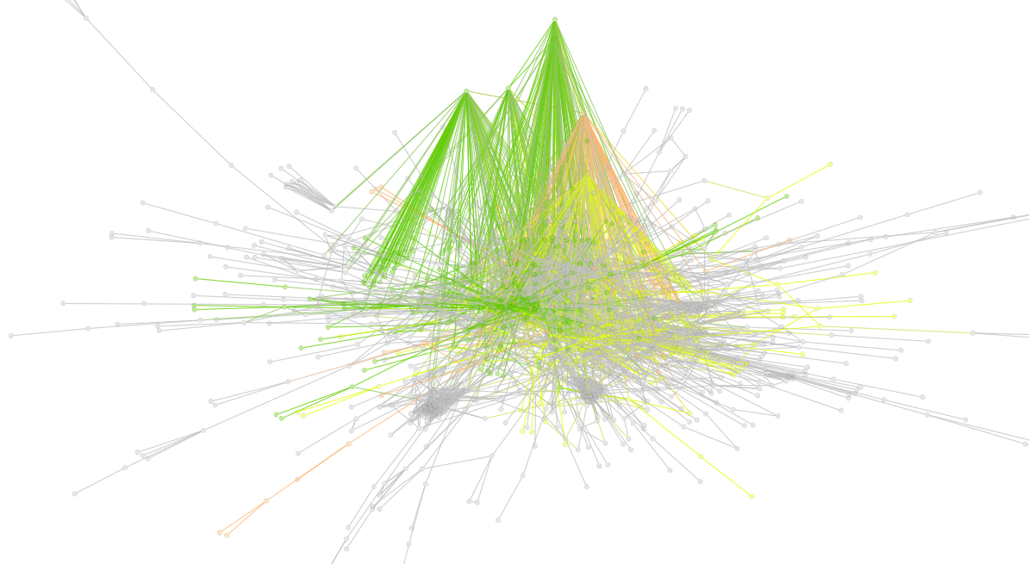
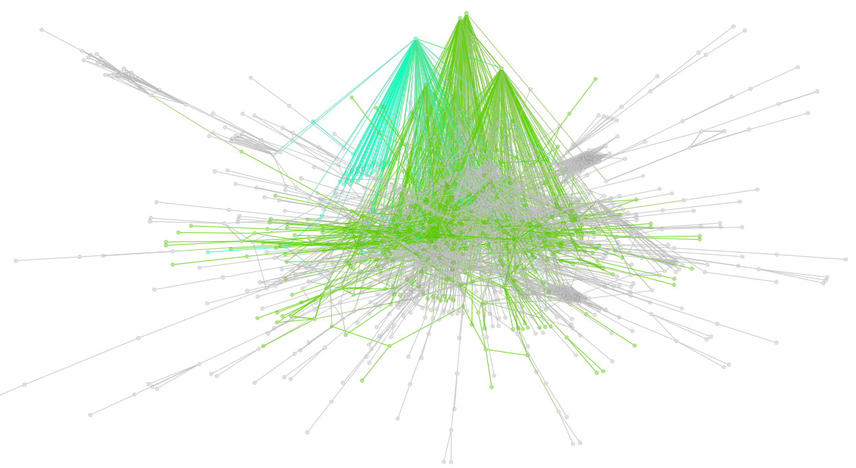
Bridges and modules
Bridges are distributed
Hsp90 bridges
evenly between the modules
Other modules’ bridges
Normal (healthy)
Hsp90 bridges
Sensitive (cancer)
ISG15
bridgeness
ISG15
HSP90A
PRKDC
HSP90B
ACTC1
Resistant (cancer)

Slide 35

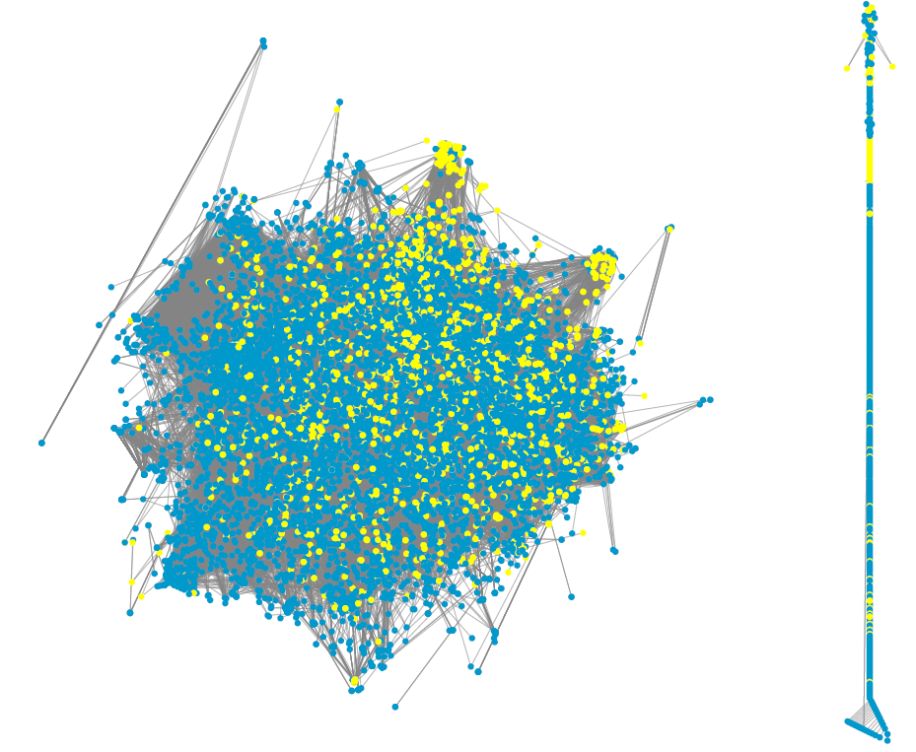




Thank you for listening!
kovacsborbala5@gmail.com
Schulc, K., Nagy, Z. T., Kamp, S., Molnár, J., Veres, D. V., Csermely, P., & Kovács, B. M. (2021). Modular Reorganization of Signaling Networks during the Development of Colon Adenoma and Carcinoma. The Journal of Physical Chemistry B, 125(7), 1716-1726.

