Slide 1
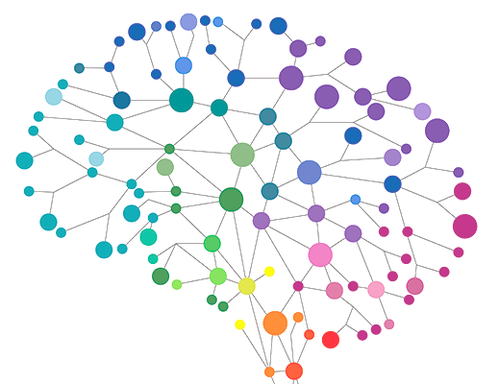
Connectomics – network neuroscience
Konnektomika: a hálózat- és az idegtudomány találkozása
Bánk G. Fenyves, MD
Department of Molecular Biology, LINK group
fenyves.bank_gabor@med.semmelweis-univ.hu
April 19, 2021
Network course

Slide 2
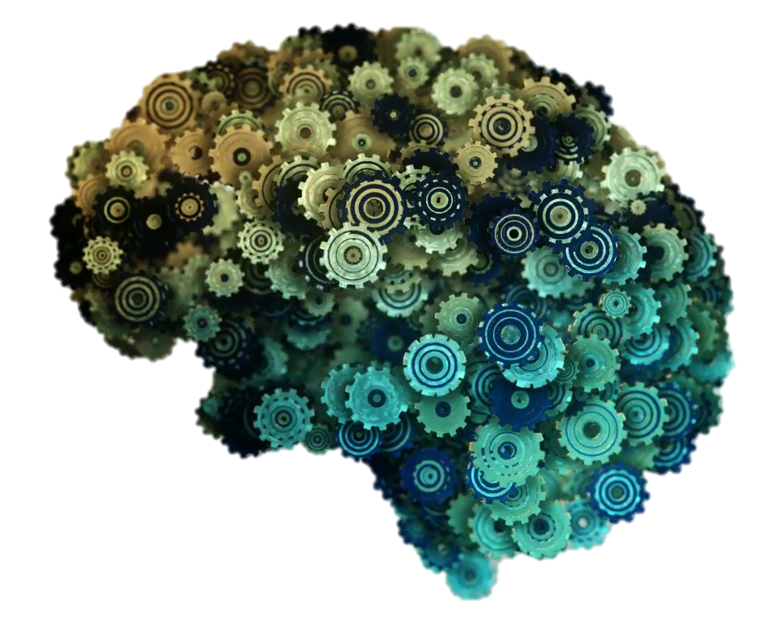

Slide 3
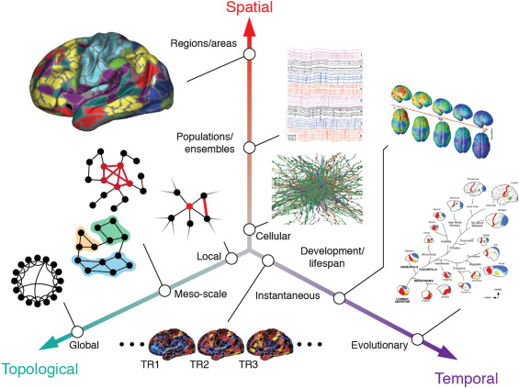
https://doi.org/10.1016/j.neuroimage.2016.11.006

Slide 4
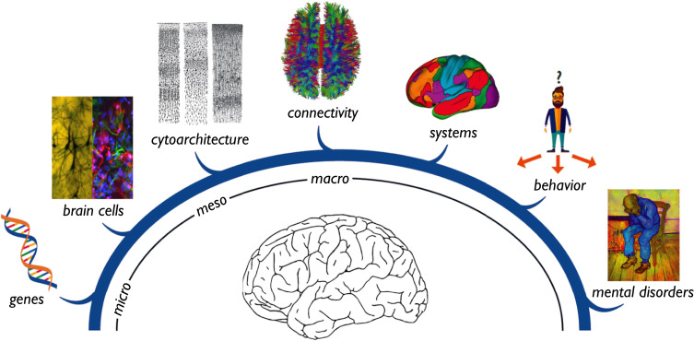
Multiscale neuroscience of mental disorders
https://doi.org/10.1016/j.biopsych.2019.05.015

Slide 5
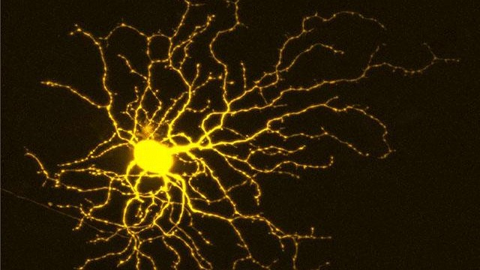
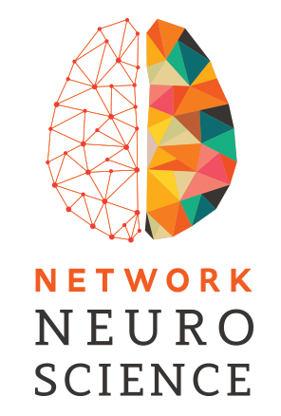
History
C. Golgi, R. y Cajal (19th c.)
  anatomy, physiology
S. Brenner (1986)
  C. elegans connection map
O. Sporns, D. Chklovskii
  theoretical & computational
Connectome: a comprehensive structural description of the network of elements and connections of a given nervous system
(Sporns et al. 2005).

Slide 6
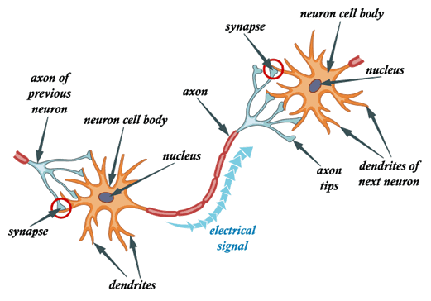
The classical unit: neuron & synapse

Slide 7
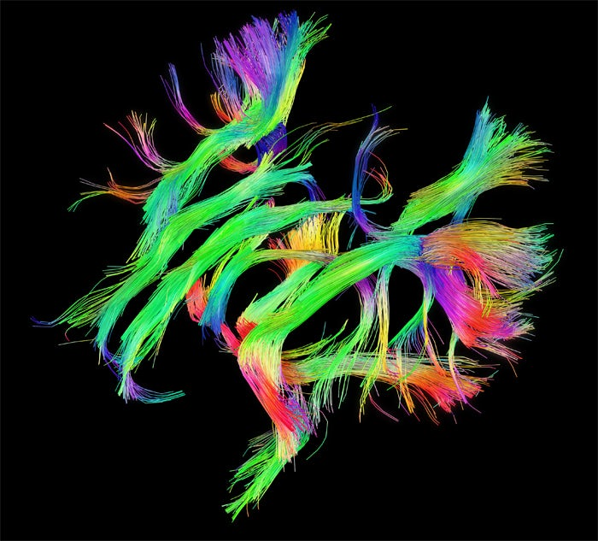
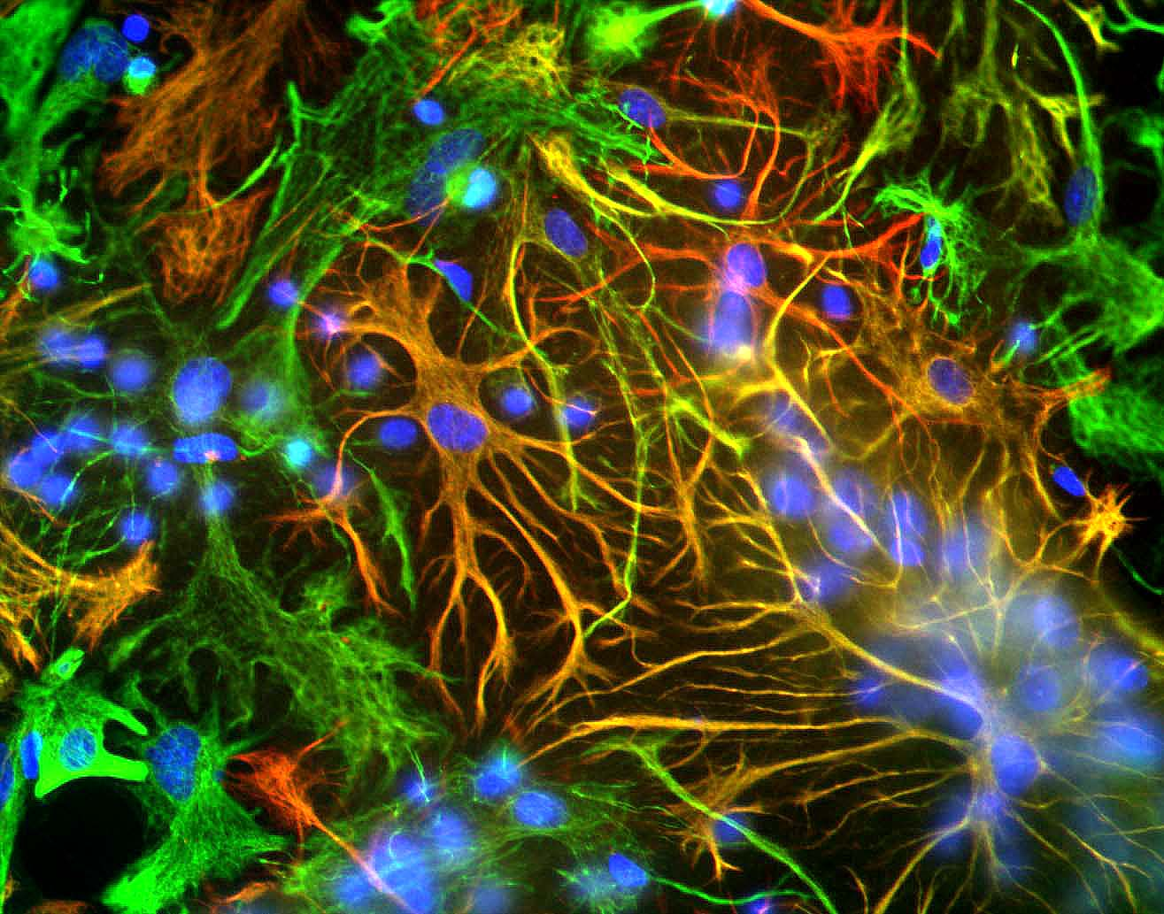
 | Neurons | Connections
H. sapiens | 100 billion | 10¹⁴
M. musculus | 7 x 10⁶ | 10¹²
D. melanogaster | 10⁵ | 10⁷
C. elegans | 302 | 6 x 10³
Human Connectome
MouseLight
FlyLight
Virtual Fly Brain
Allan Brain Atlas
FlyCircuit
NeuronBridge

Slide 8
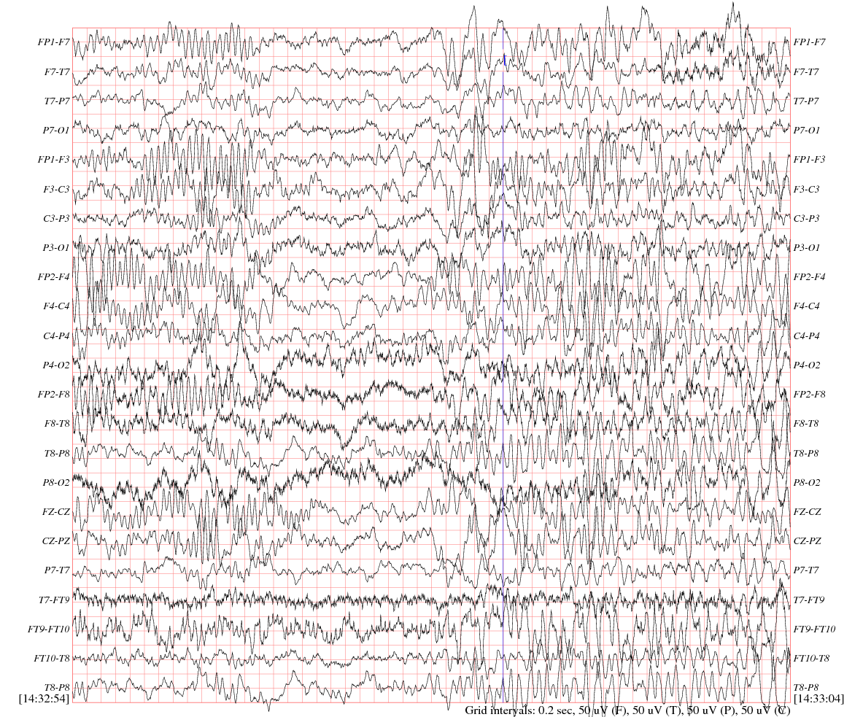
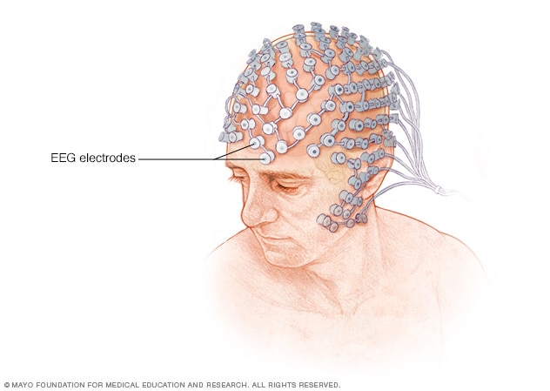
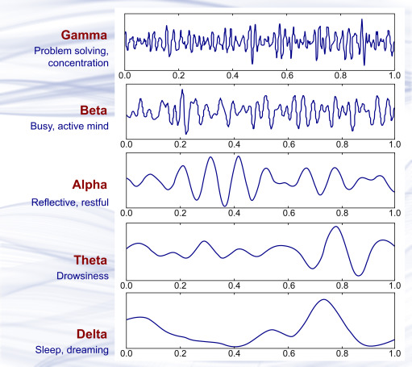

Slide 9
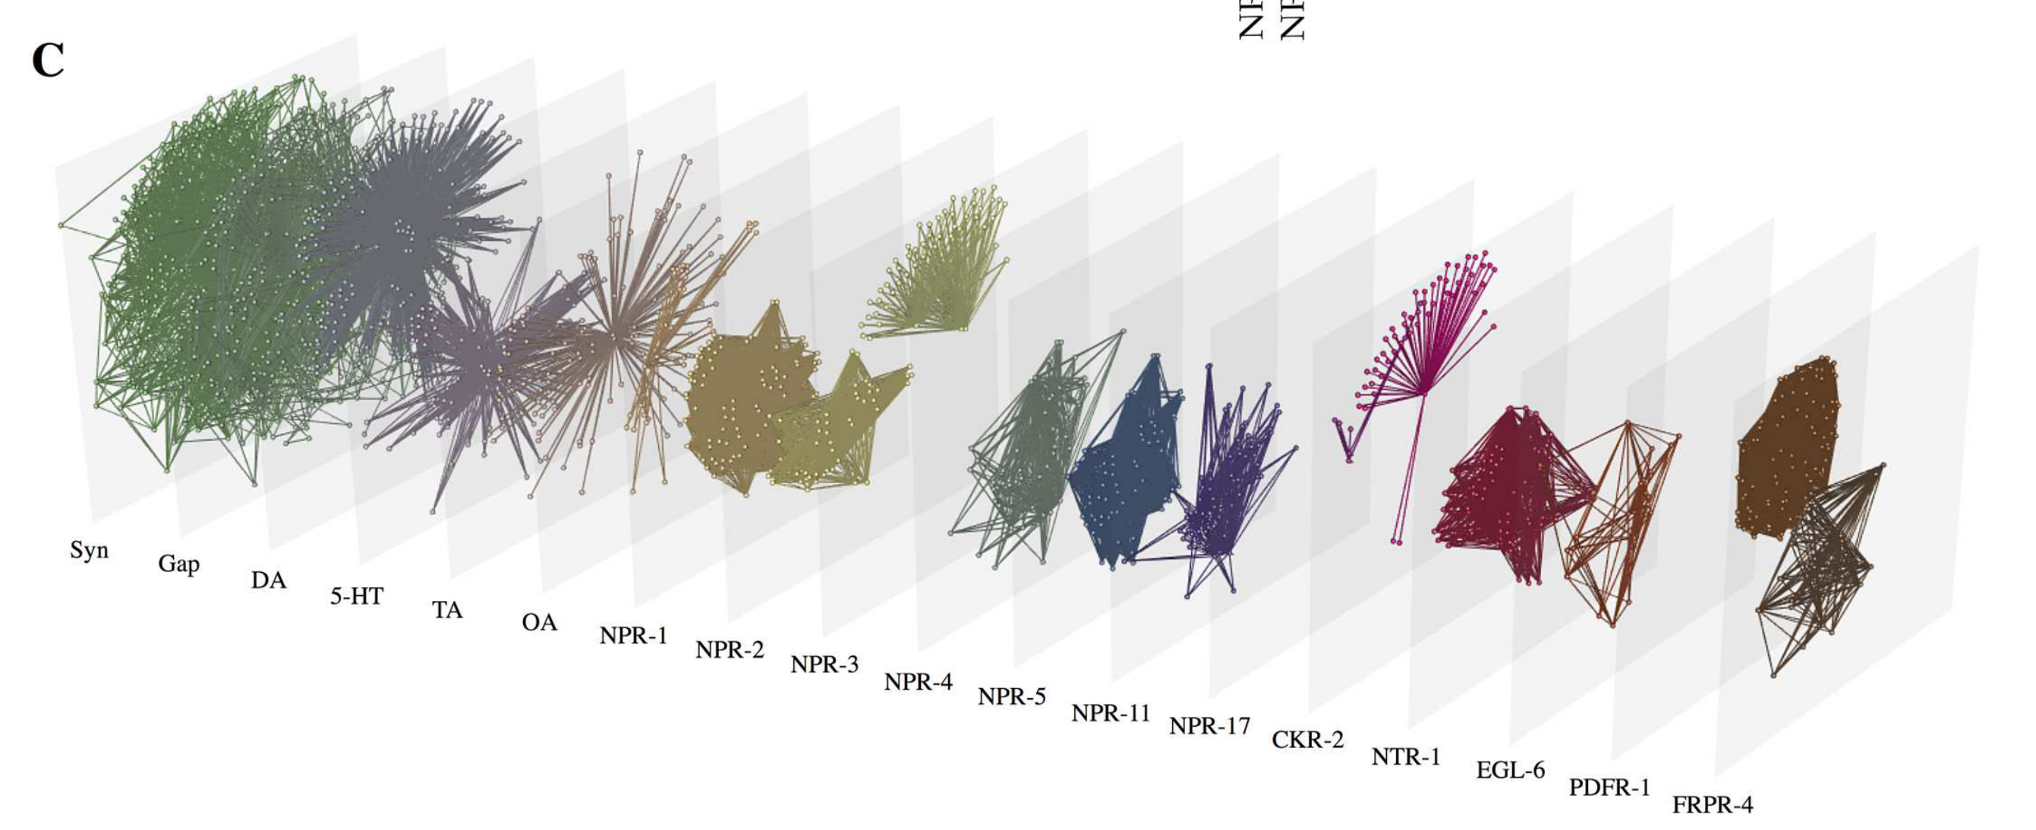
Brain is a multi-layer network
neurons
  synaptic: chemical vs. electrical
  extrasynaptic – aka. „wireless” connectome
glia
circulation

Slide 10
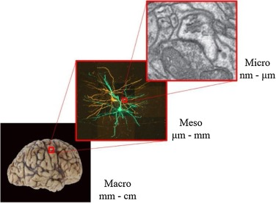
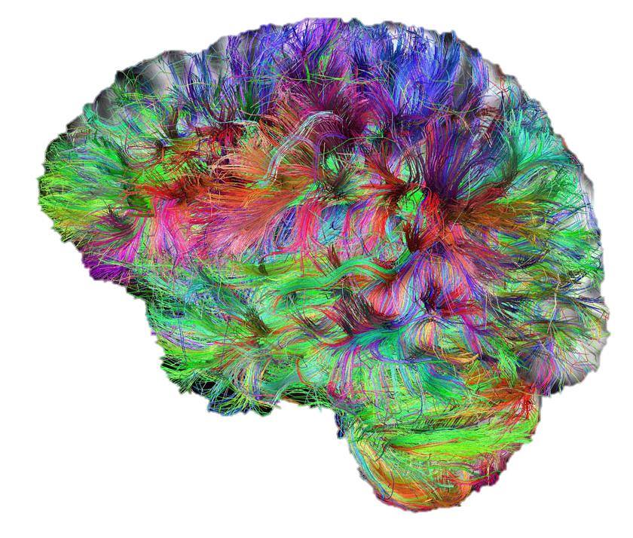
Challanges
multiple scales
  micro » meso » macro
temporal dynamics
  development
  neuroplasticity
interindividual variability
MR tractography
https://doi.org/10.1016/j.neubiorev.2018.03.001

Slide 11
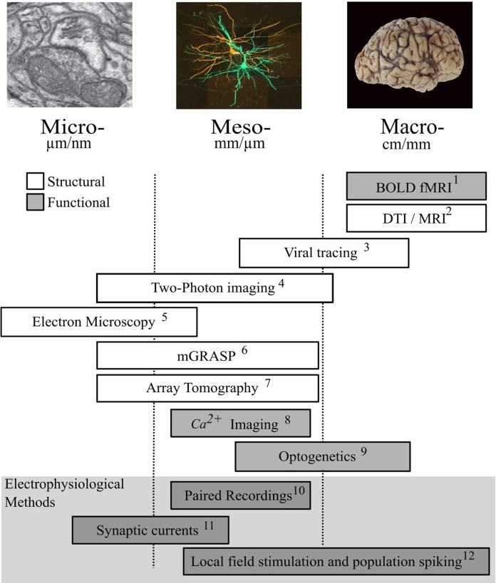
Multiple connectome scales
https://doi.org/10.1016/j.neubiorev.2018.03.001

Slide 12
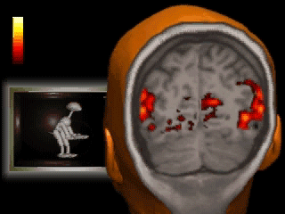
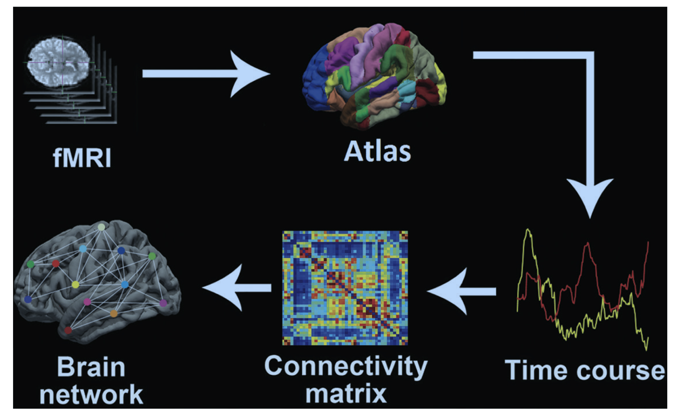
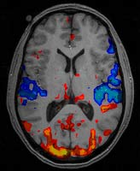
Macroconnectome
fMRI BOLD
activation inhibition
http://www.mhs.ox.ac.uk
https://pubs.rsna.org/doi/pdf/10.1148/radiol.2019194009

Slide 13
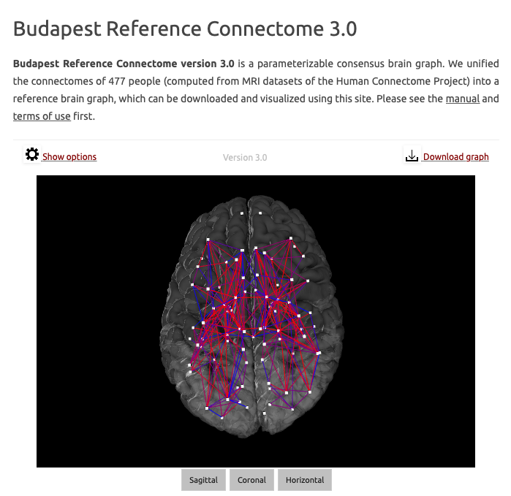
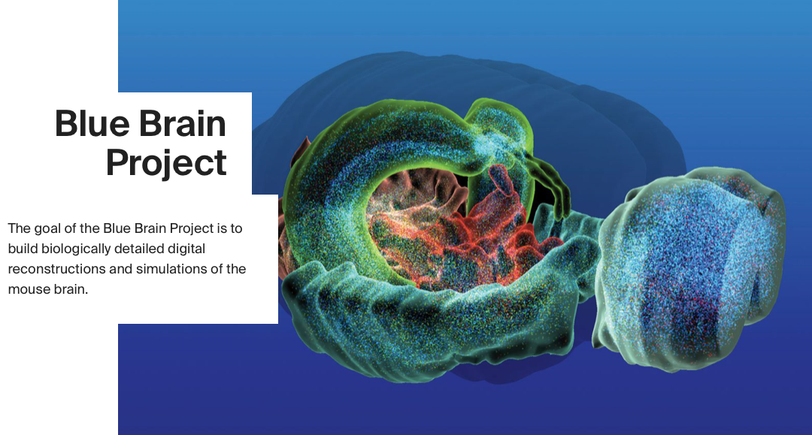
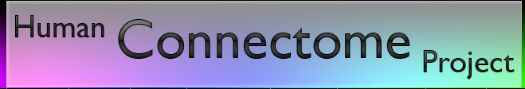
Macroconnectomes
https://pitgroup.org/connectome/

Slide 14
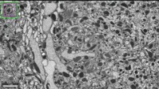
Microconnectivity: electronmicroscopy
Credit: FlyEM/Janelia Research Campus, 2020

Slide 15
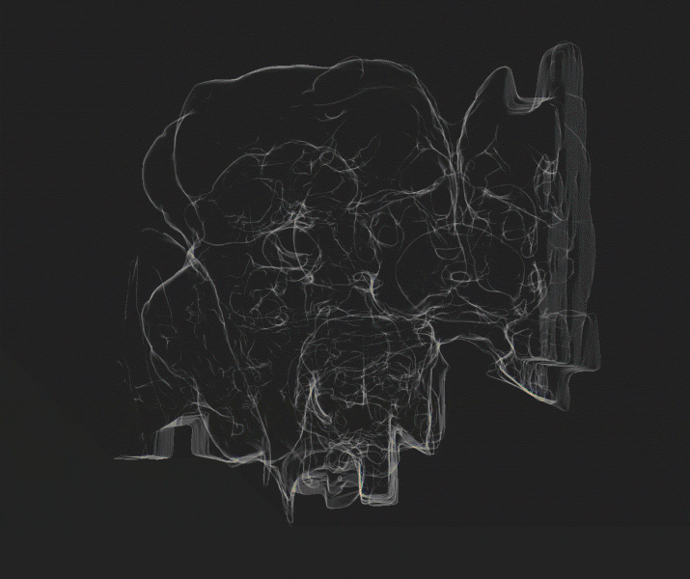
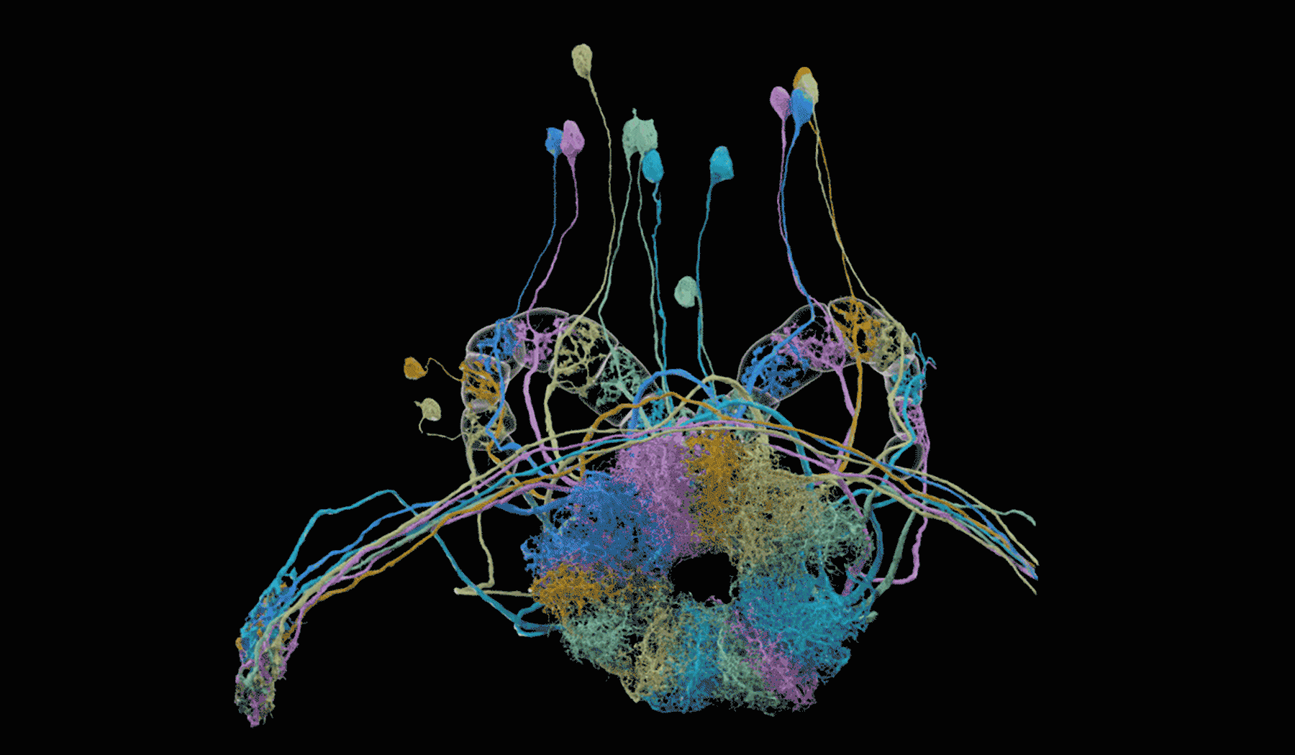
Micro/mesoconnectomes: Drosophila
FlyEM
25.000 neurons (out of 100.000)
~10⁶ connections (out of 10⁷)
doi:10.1101/2020.01.21.911859
FlyEM/Janelia Research Campus, 2020

Slide 16
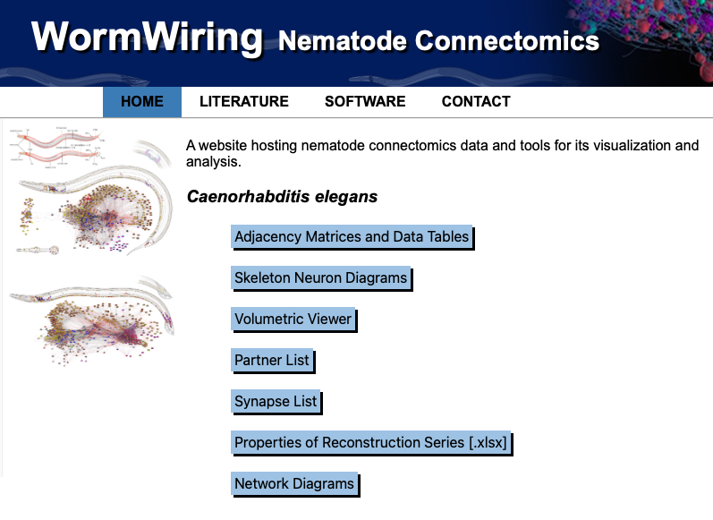
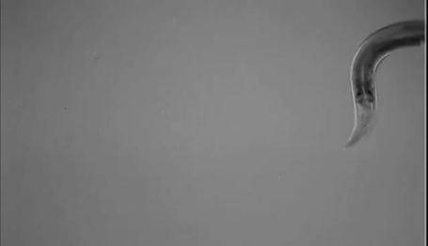
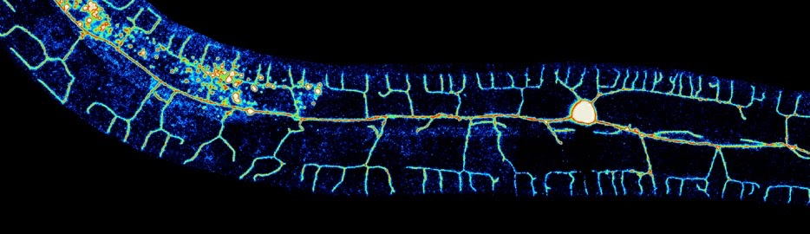
Micro/mesoconnectomes: C. elegans
„fully reconstructed nervous system”
302 neurons
~5000 connections
chemical synapses
gap junctions
Cook et al. Nature (2019)
https://www.wormatlas.org/neuronalwiring.html

Slide 17
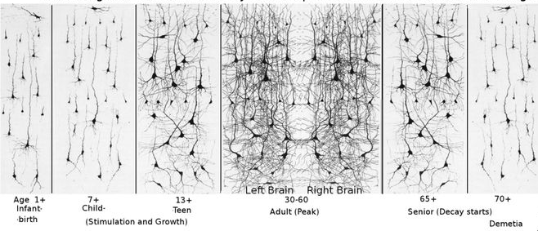
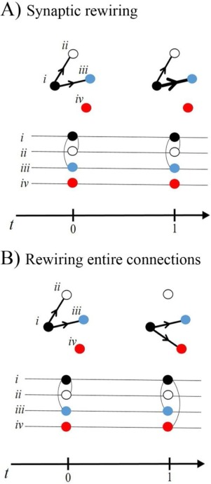
Challange II:
Structural dynamics (rewiring)
Developement Learning Disease Aging
„neuroplasticity”
„synaptic plasticity”

Slide 18
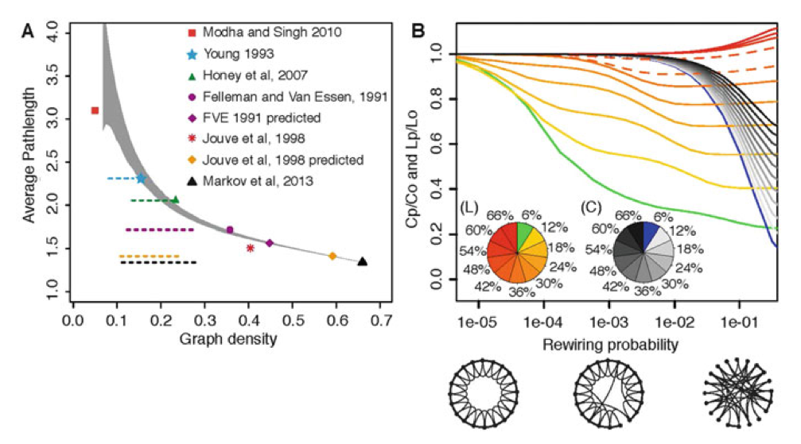
Micro-, Meso- and Macro-Connectomics of the Brain. (2016). Research and Perspectives in Neurosciences. https://doi.org/10.1007/978-3-319-27777-6

Slide 19
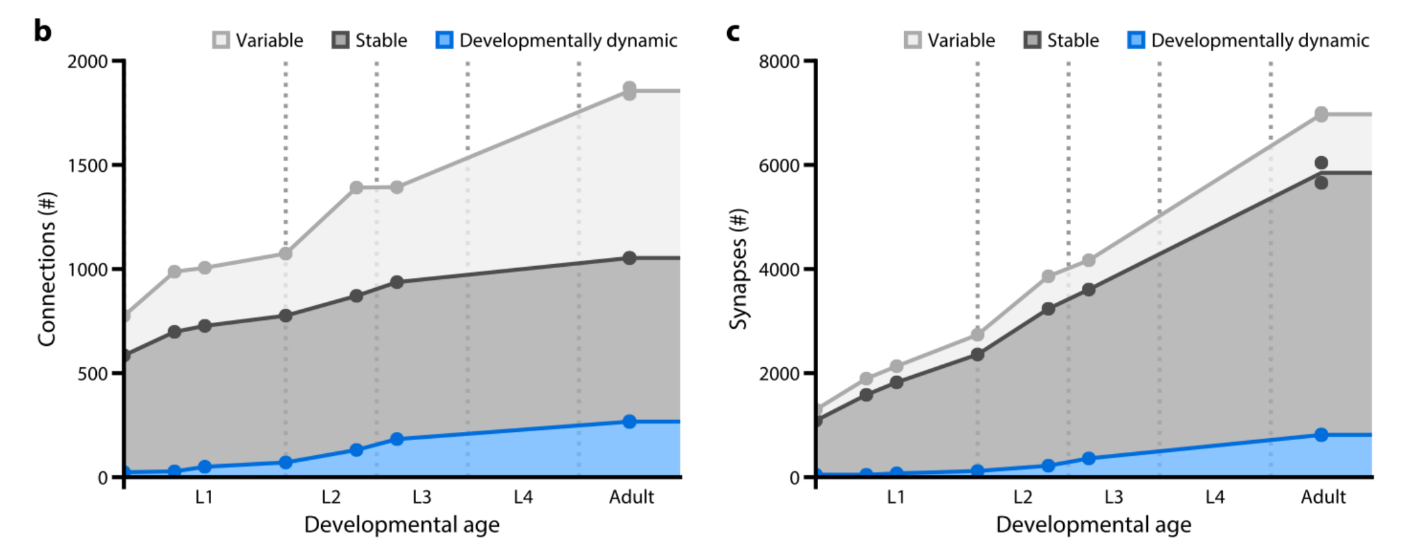
Challange III:
Interindividual variability
43%
72%
43%
14%
avg. synapse # per connection
6.6±5.8 synapses (stable)
1.4±1.0 synapses (variable)
weak connections are more variable
C. elegans
Witvliet, D. et al. (2020). BioRxiv. https://doi.org/10.1101/2020.04.30.066209

Slide 20
Network terms
node = e.g. neuron
  color / shape: qualitative attribute
    e.g. sensory vs. motor neuron
  size: quantitative attribute
    e.g. degree
edge = e.g. interneuronal connection
  color / type: qualitative attribute
    e.g. neurotransmitter type; polarity
  weight: quantitative attribute
    e.g. axonal width; synapse number
  direction: in directed networks
    e.g. unidirectional vs. bidirectional

Slide 21
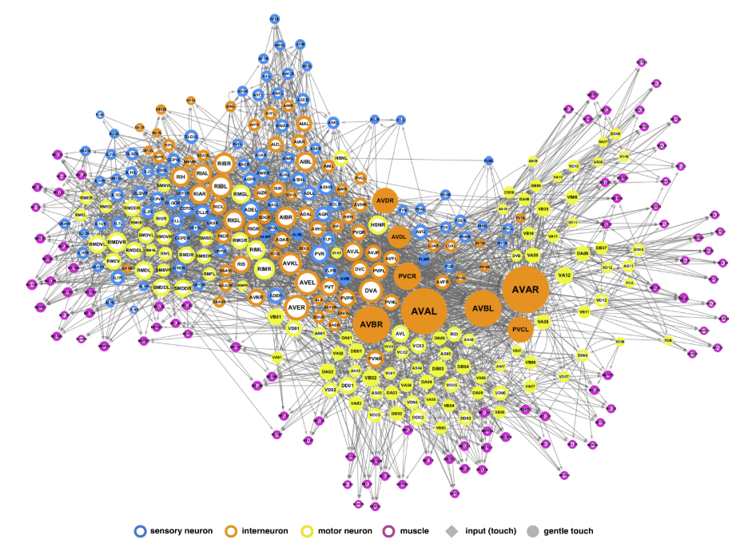
Network representations I.
node size: degree
Yan G., et al. (2017) Nature. ﻿doi:10.1038/nature24056
C. elegans neuromuscular system

Slide 22
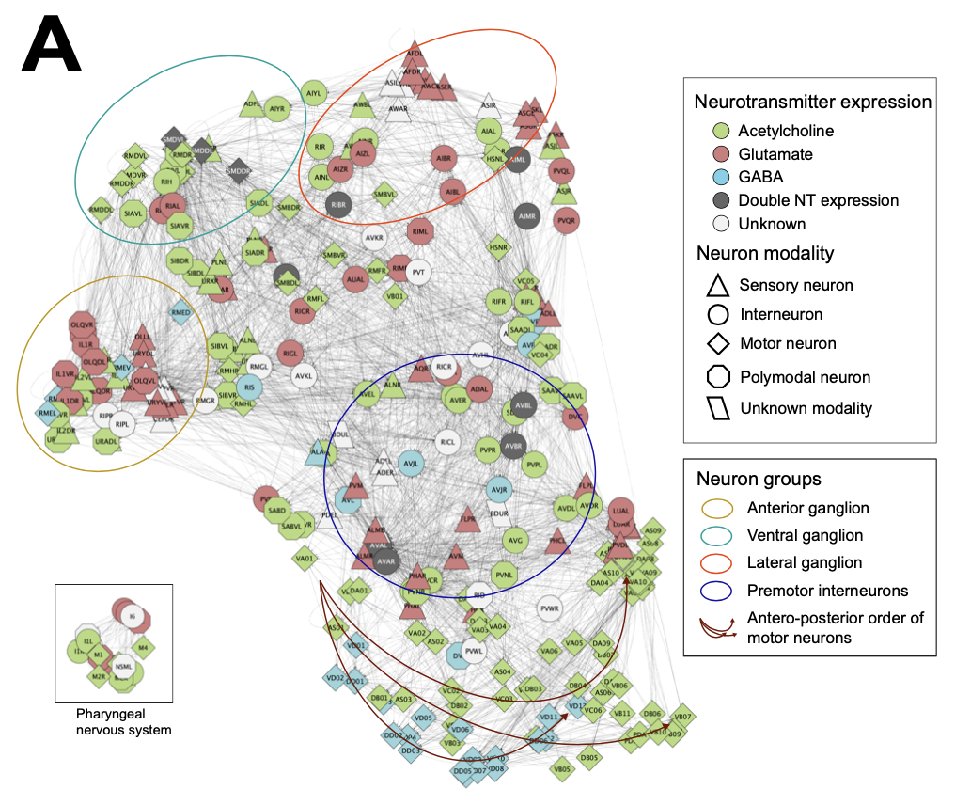
Network representations II.
Fenyves, B. et al. (2020). PLOS Comp. Biol., 16(12), e1007974
EntOpt Cytoscape plugin

Slide 23
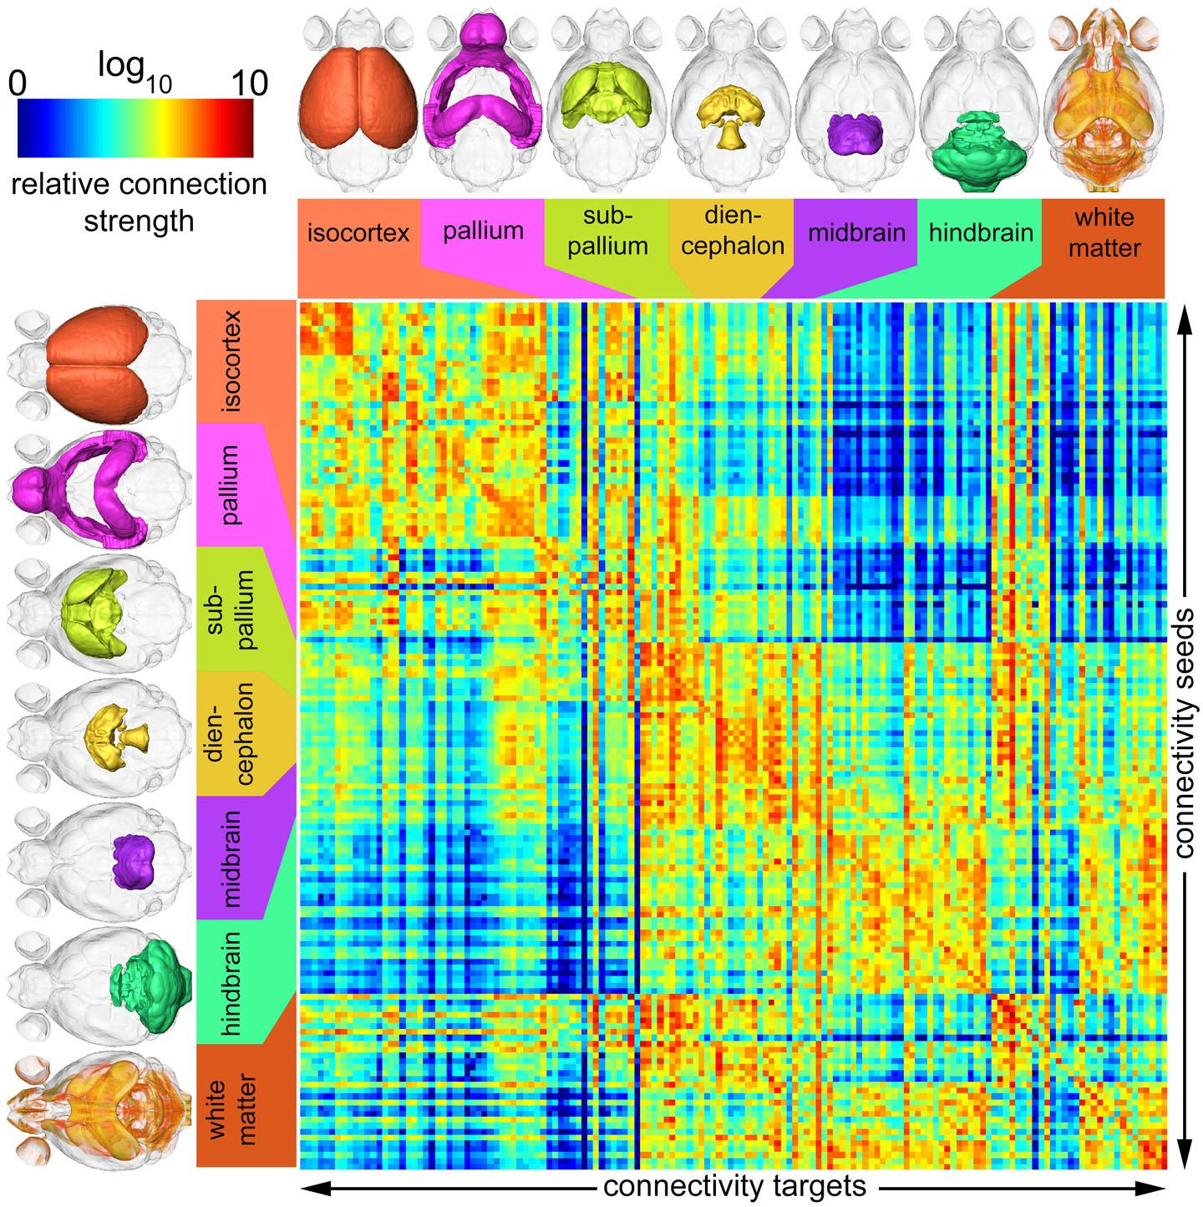
Network representations III.
Connectivity matrix
strong reciprocity
weak reciprocity
Credit: Duke Medicine

Slide 24
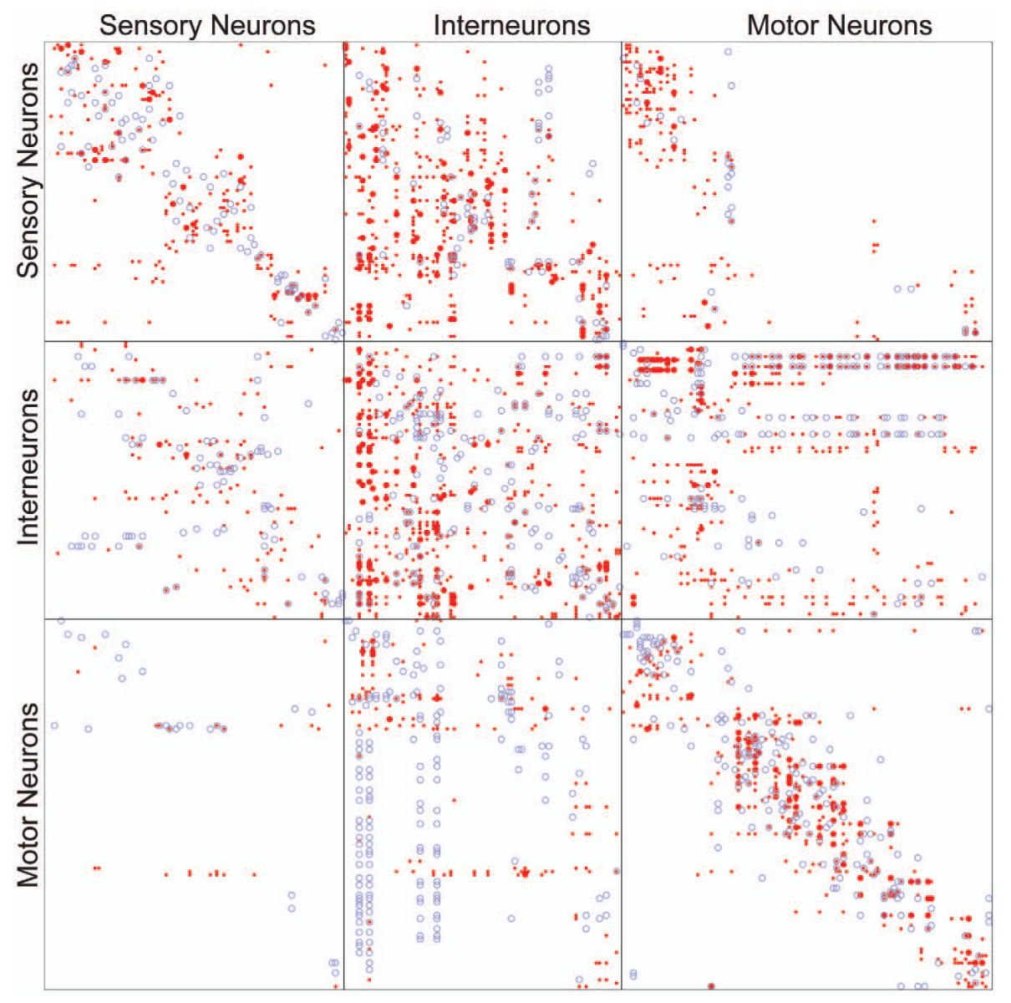
Network representations IV.
● chemical connection
○ gap junction
C. elegans
Varshney et al. (2011). PLoS Comp. Biol.

Slide 25
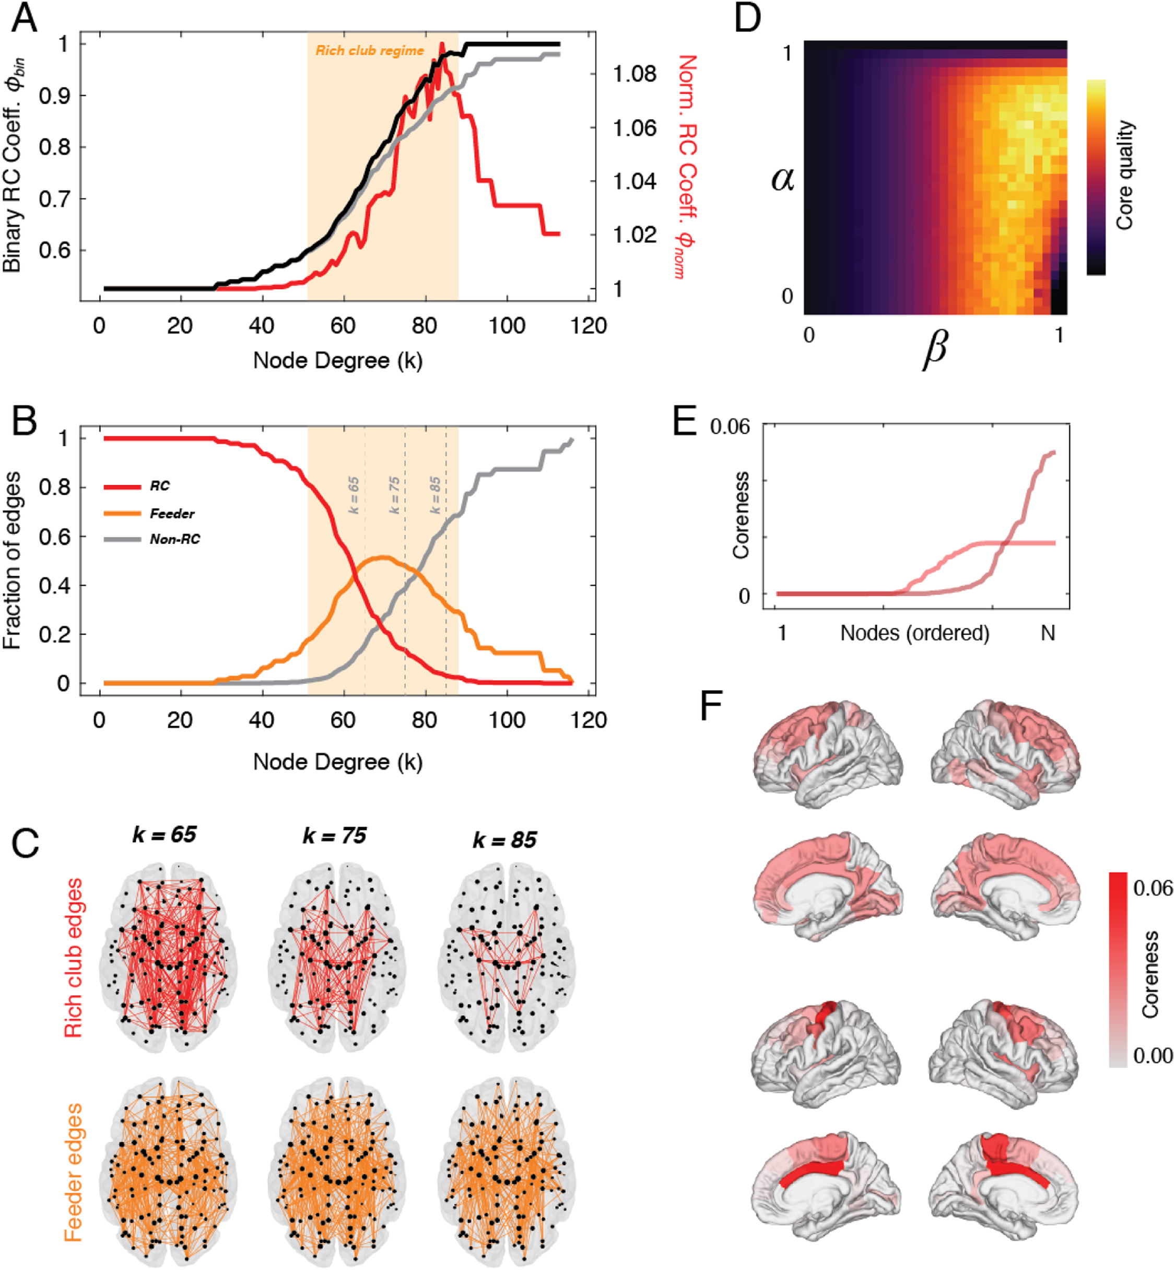
Network properties: core-periphery
rich club: hubs (high degree, high strength nodes) that are also densely interconnected to one another
Betzel et al. (2017) NeuroImage (160) 73-83

Slide 26
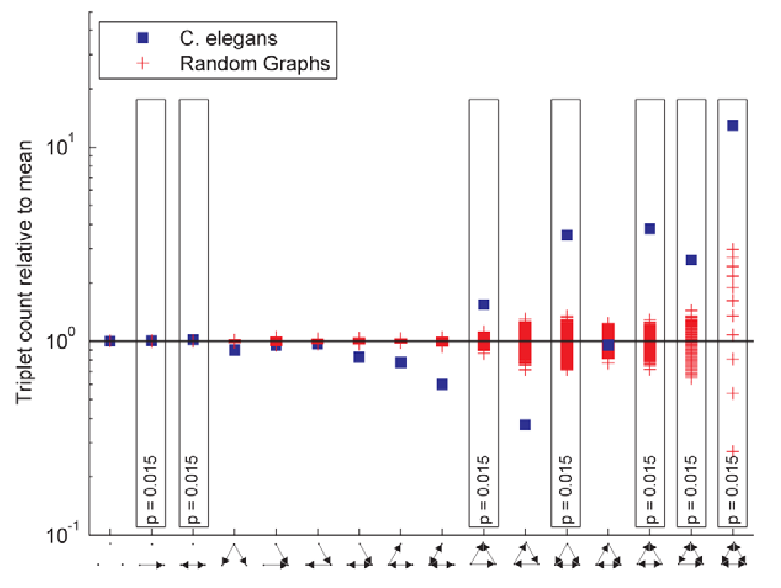
Network properties: motif analysis
Motif: recurrent subgraph that occurs significantly more frequently in a larger network than expected
feed-back
feed-forward
integrator
chain
Varshney et al. (2011). PLoS Comp. Biol.

Slide 27
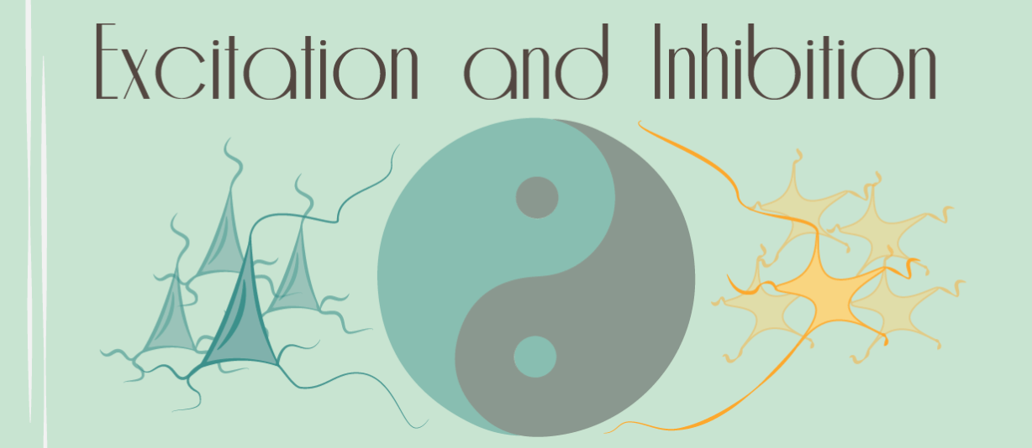
Network properties: polarity
sign balance
inhibitory
excitatory
Network | Proportion of negative edges
Rat hippocampus | 5-30%
Rat excitatory neocortical neurons | 20%
Cerebral cortex (GAD expression) | 10-20%
Optimal network for synchronized bursting activity (in silico) | 10-20%
Primary visual cortex (V1; in silico) | 25%
Neuronal network (ex vivo) and neuronal network model (in silico) | 20%
Wikipedia, Epinions, Slashdot (social networks) | 15-23%
University freshman network (social) | 12-14%
International relations (war) network | 5-13%

Slide 28
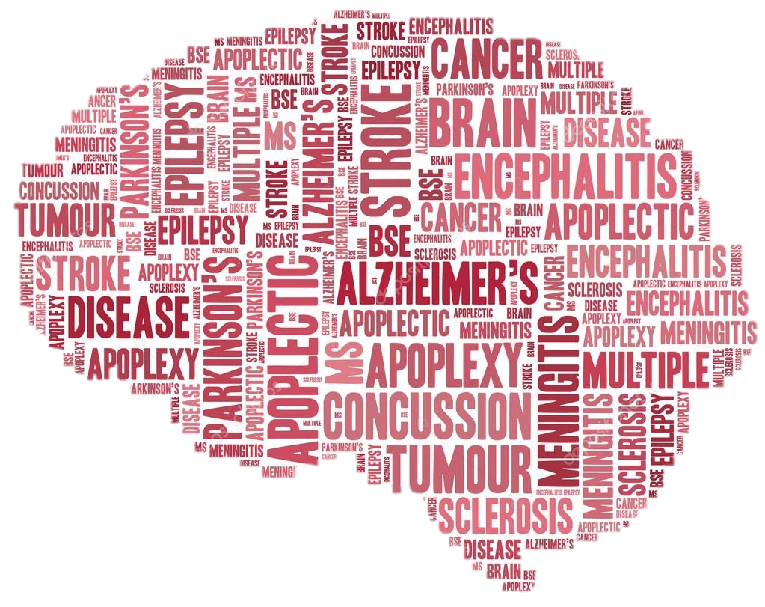
Sign imbalance
stroke
ischemia
PTSD
epilepsy

Slide 29
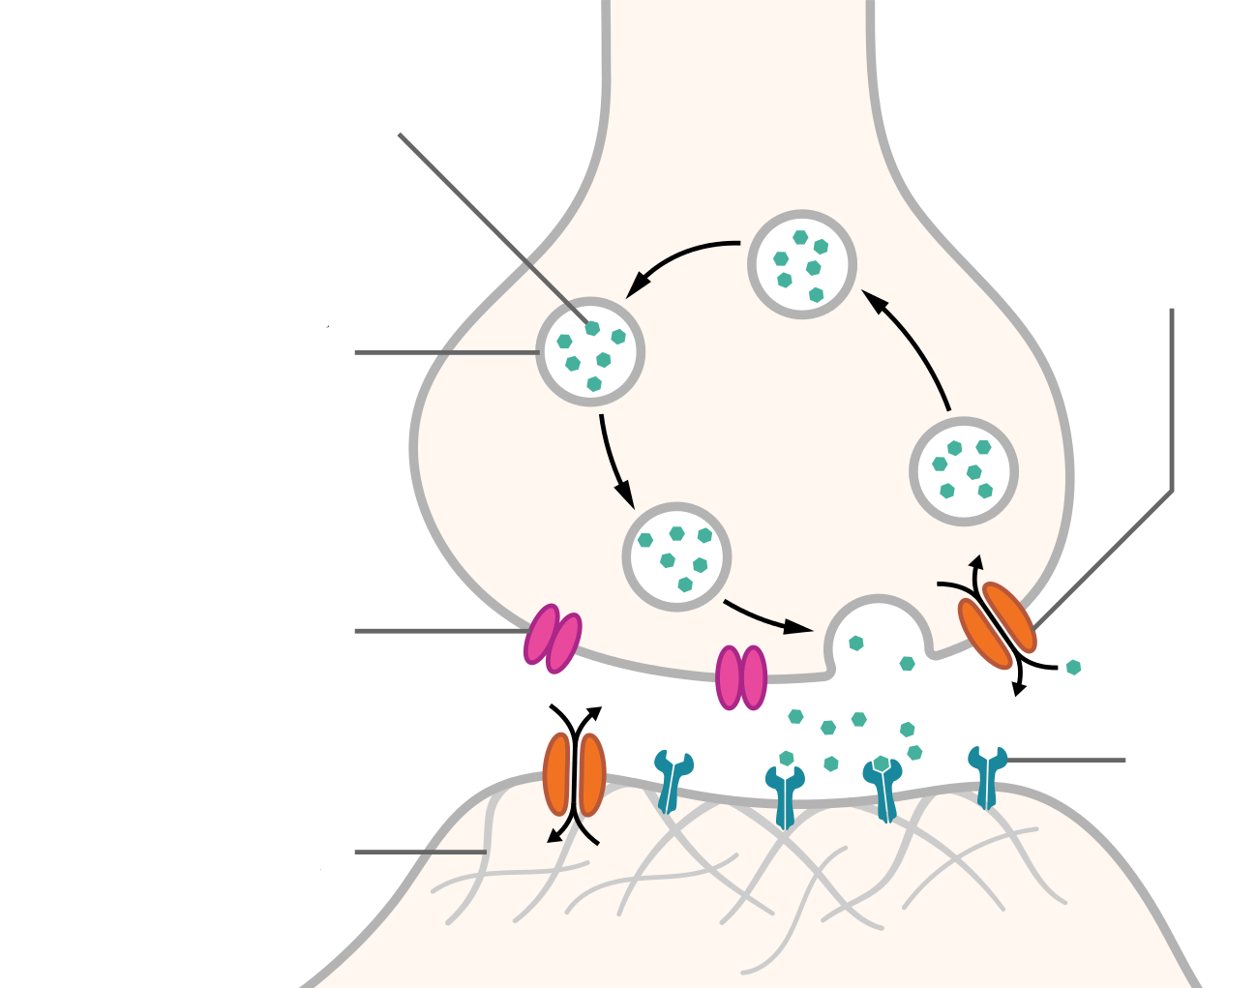
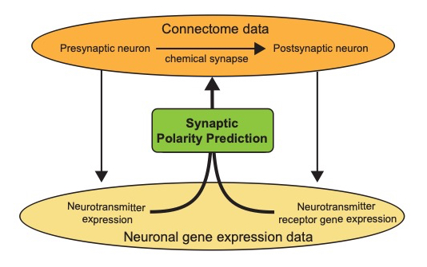
Polarity prediction
glutamate acetylcholine GABA
cation channel anion channel
Na⁺
Cl⁻
inhibitory
excitatory
excitation
inhibition
complex

Slide 30
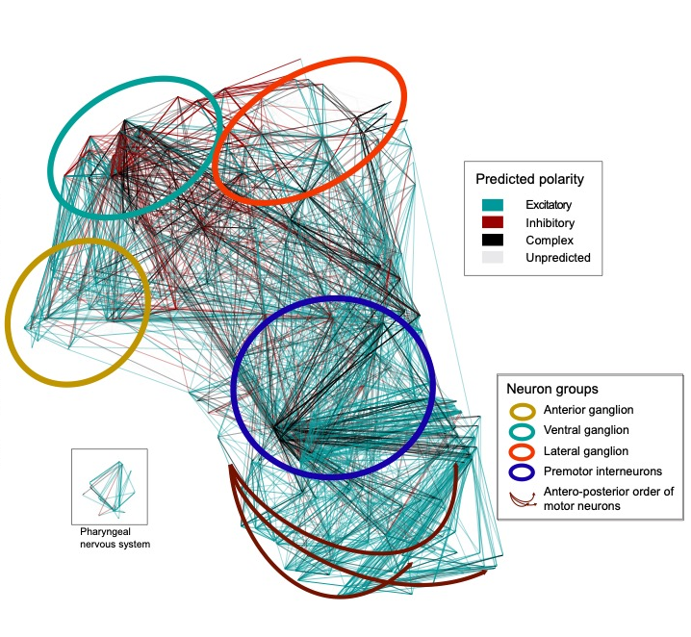
Polarity-colored connectome
Fenyves et al. (2020) PLoS Comp. Biol.
Notes:
Additionally, when coloring the connections in this network representation based on the predicted polarities of the represented synapses, we are able to link certain inhibitory or complex-dense regions to anatomical or functional clusters of neurons.
For example, the many connections related to the ventral ganglion predicted to be inhibitory.

Slide 31
Excitatory:inhibitory balance between functional neuron groups
Sensory neurons
Interneurons
Polymodal
neurons
10x inhibitory excess
13x excitatory excess
Motor neurons
sensory » inter » motor: forward excitatory excess
motor » inter » sensory: backward inhibition excess
numbers represent E:I ratios
Notes:
When digging a bit more into details, tt’s quite interesting to see what the excitatry:inhibitory ratios look like when the neurons are grouped based on their modalities.
We can see that connections going in the forward directions, namely from sensory to inter to motor neurons present an excitatory exces. Conversely, the backward directions, so for example the motor to interneuron direction, show an inhibitory excess.

Slide 32
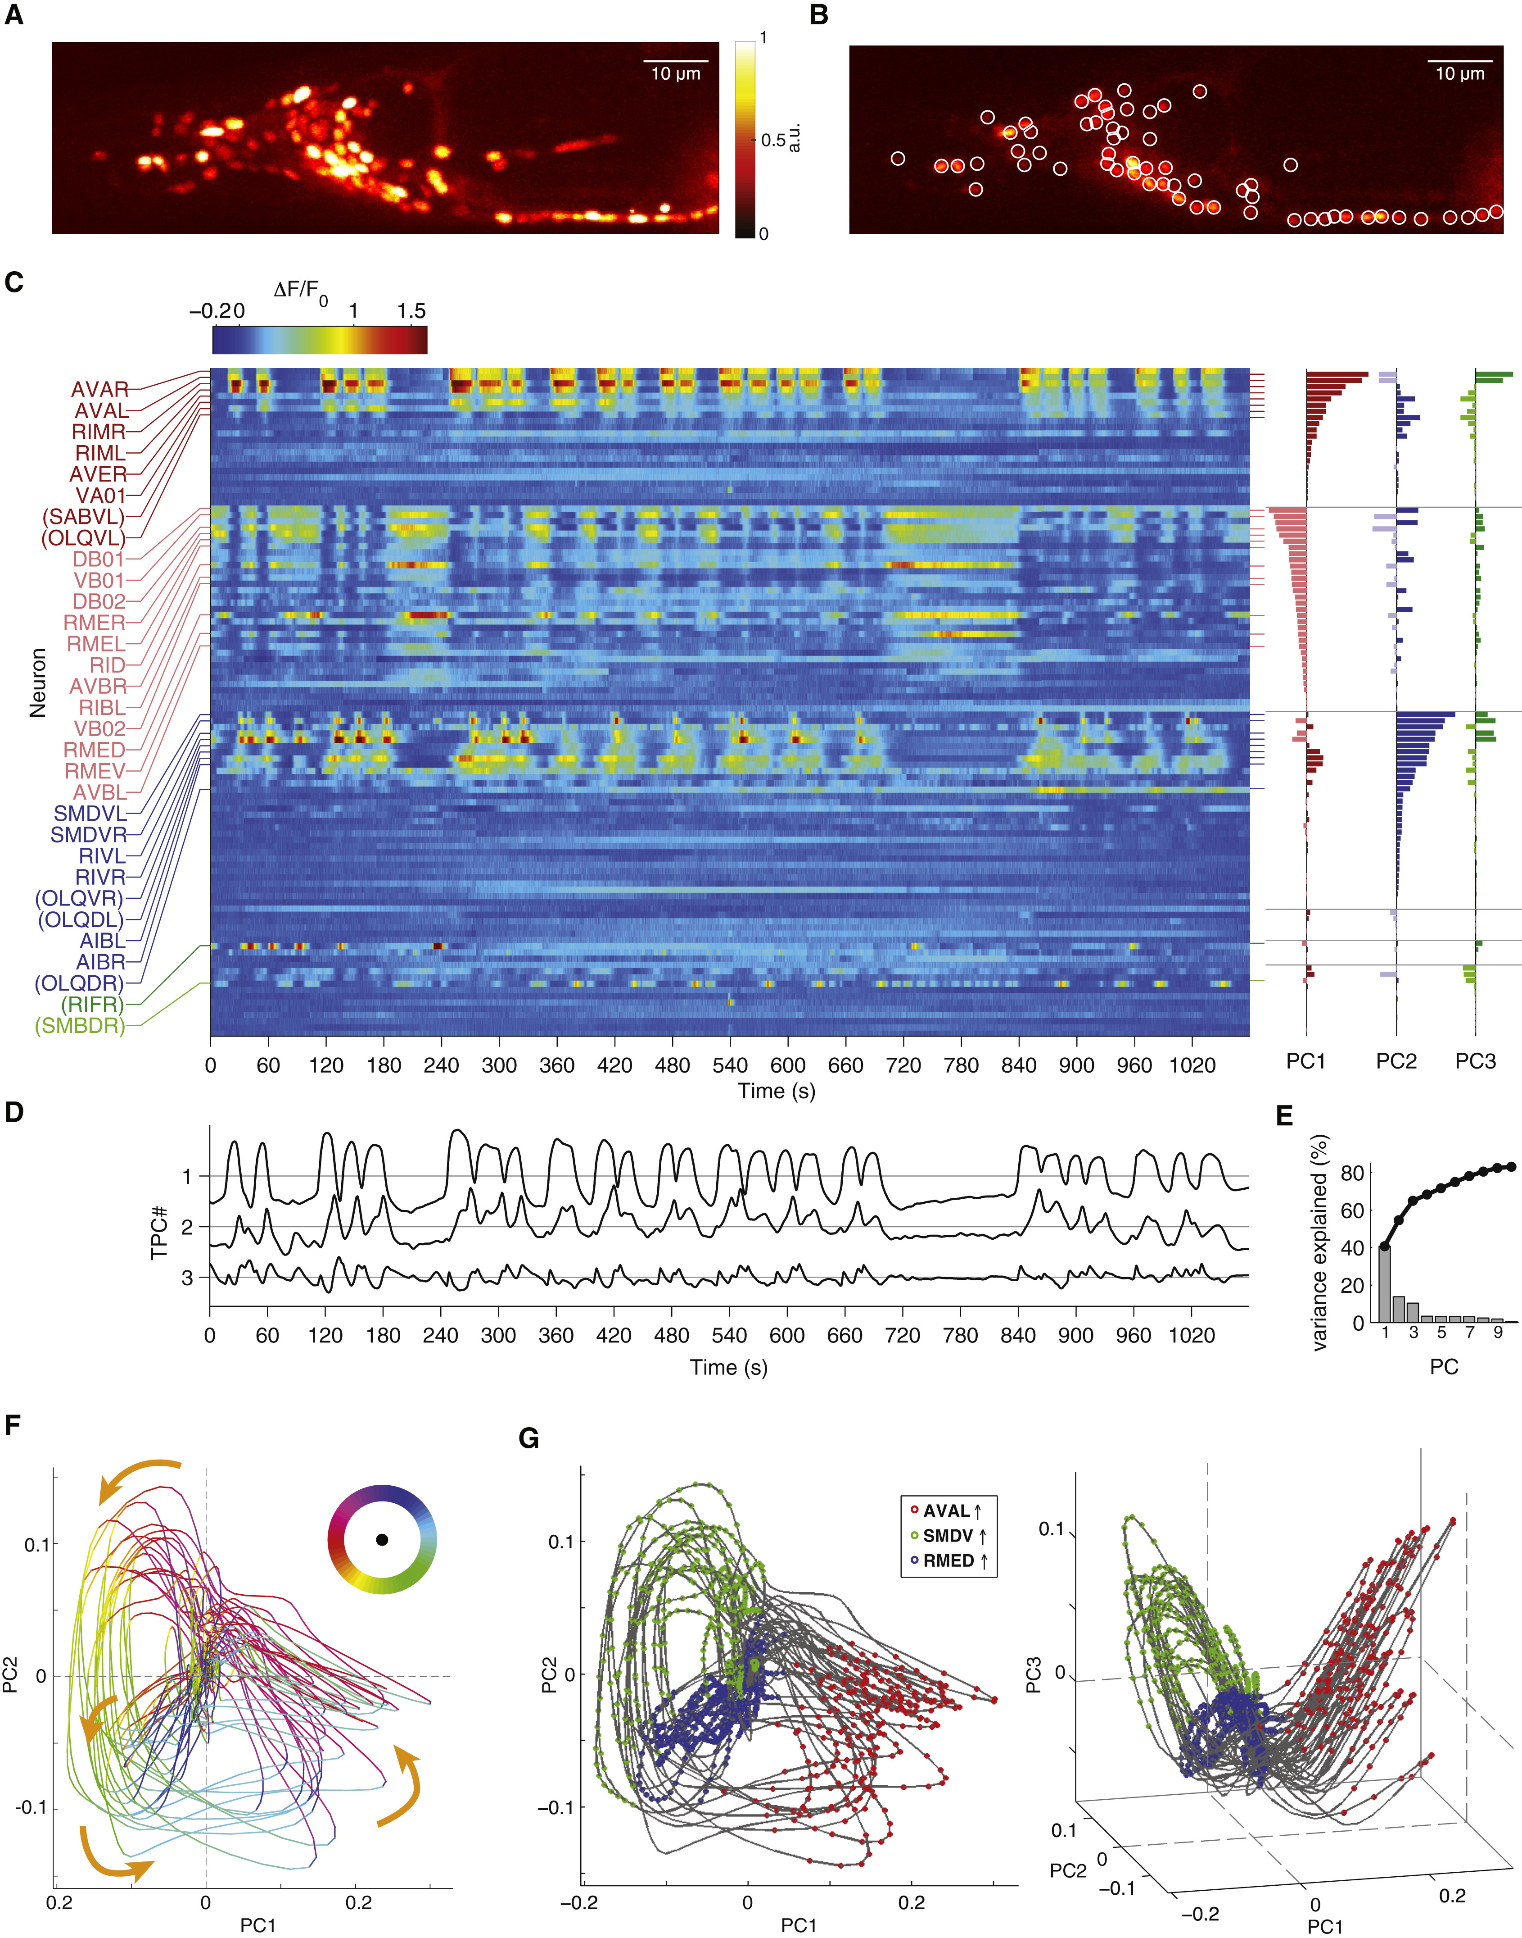
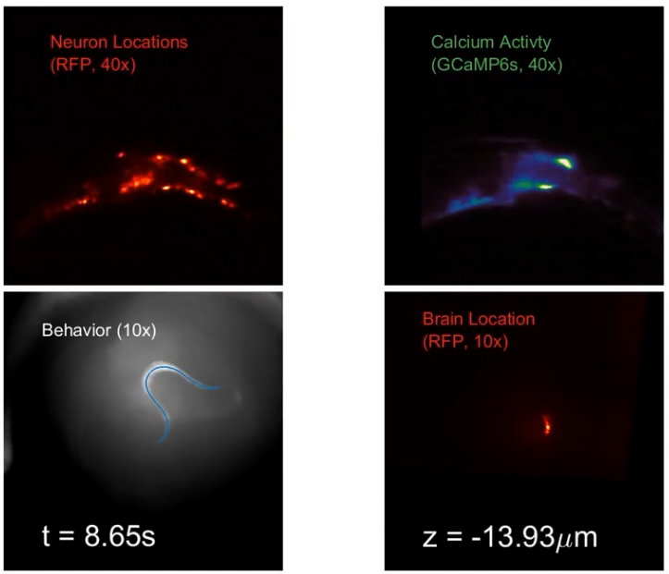
Kato et al. Cell (2015)
Brain dynamics
Nguyen et al. PNAS (2015)

Slide 33
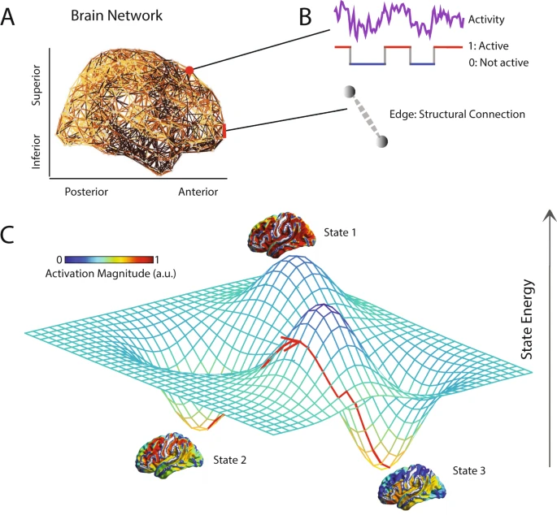
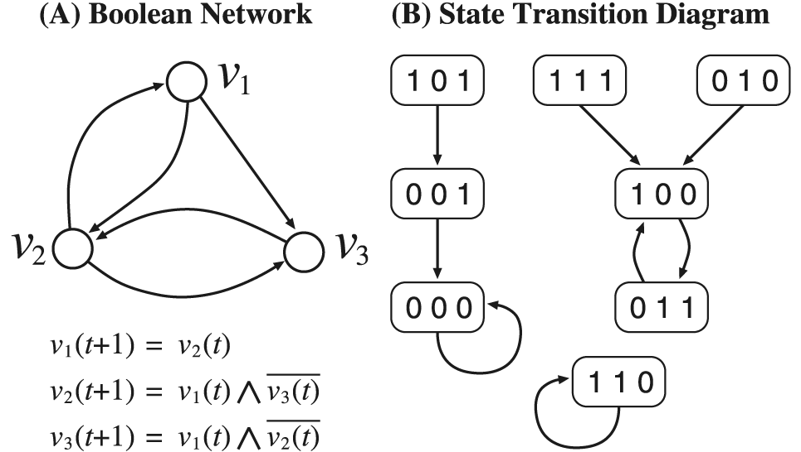
Dynamic brain networks
Boolean network models
https://doi.ieeecomputersociety.org/10.1109/TCBB.2012.87
https://doi.org/10.1038/s41598-018-20123-8

Slide 34
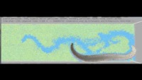
Simulated neuromechanical system
Credit: OpenWorm / Sibernetic

Slide 35
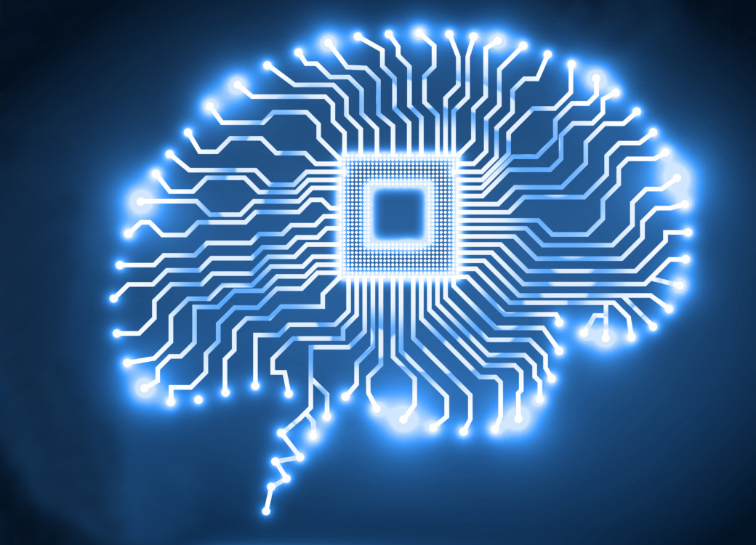
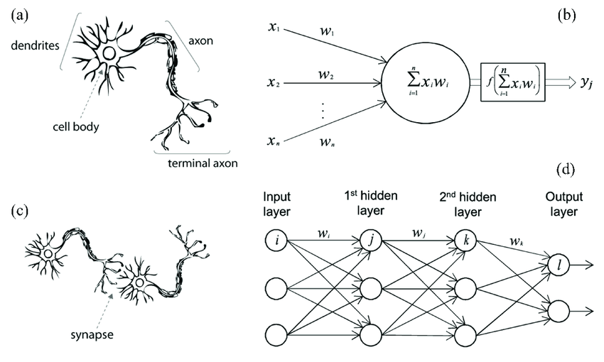
Neuronal vs. neural networks
biological vs. artificial
AI
Machine learning
Deep learning

Slide 36

Summary
Bassett, D., Sporns, O. Network neuroscience. Nat Neurosci 20, 353–364 (2017).

Slide 37


Thank you!
Köszönöm a figyelmet!
ÁOK
FOK
http://report.semmelweis.hu/linkreport.php?qr=O0C3XIEMWX5MDH6J
http://report.semmelweis.hu/linkreport.php?qr=E57T7E0VHDKADR3R
fenyves.bank_gabor@med.semmelweis-univ.hu

